Slide 1
ACESSING SUPPORT FROM MENTAL HEALTH SERVICES CONSIDERATIONS FOR HOUSING WORKERS
Barney Wells
Enabling Assessment Service London.

Slide 2
Written Guidance
https://www.homeless.org.uk/working-with-mental-health-services

Slide 3
What I will cover
- Reflections and advice on how best to support someone you are working with in accessing mental health services
- Where to go for additional guidance
This is based on my experiences as mental health social worker involved with homeless services for many years

Slide 4
Over-arching theme?
It’s the quality of the conversation that counts
Service user
Colleagues
Over professionals
Finding ways to improve this and tackle barriers which might diminish

Slide 5
What I won’t cover
Details of exact pathways and processes
- These vary from area to area – attendees today are from too many places, plus things change

Slide 6
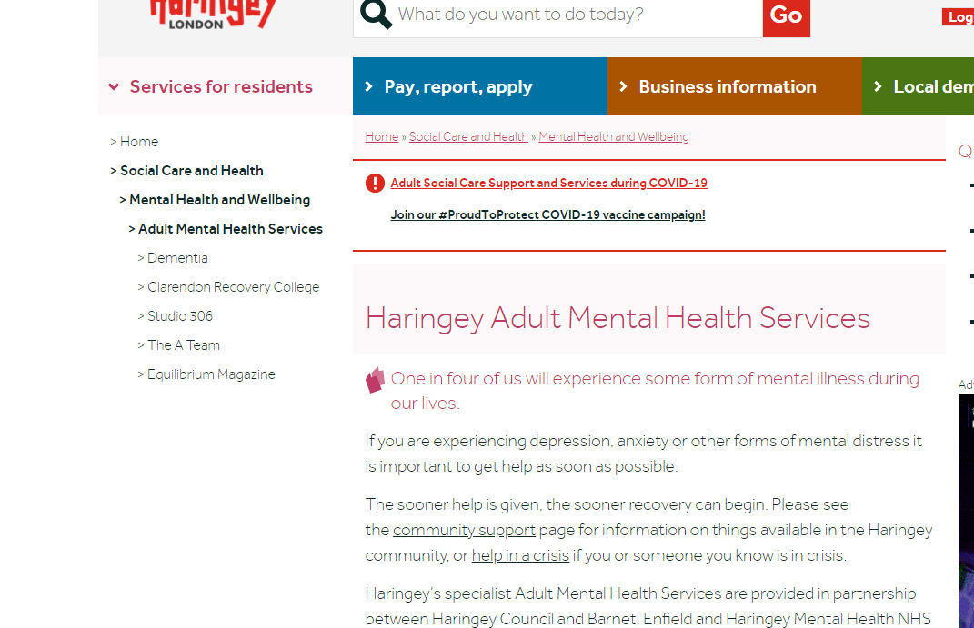
Research, in advance. Internet is useful, don’t leave it there. Plan, clarify, discuss agree Speak with colleagues, GPs, commissioners. Have information available – check that its up to date before you rely on it Possible to identify a point of contact in local statutory services?

Slide 7
As a worker from a housing setting…
Your appropriate role is going to vary, because of the nature of your post and the project
A keyworker in a high support project on a mental health pathway is going to be involved in a different way to a floating support worker in a more general needs project
But don’t let your role alone define how you respond to someone who may be experiencing mental health difficulties
Being kind and thoughtful and, where possible, making time – is always going to be the best starting point

Slide 8
Value what you might bring
Housing!
Being there and helping with small practical problems
Allowing time for people to talk about what they want or what might be bothering them
Supporting people to register with a GP and giving information about services they can self-refer to may be exactly what someone wants and be the important empowering act you can take
Panicking and handing over leaflets or talking immediately about process when someone wants to talk to you may not be helfpful

Slide 9
Look after yourself
Talking with colleagues – including regular supervision
Discuss your decisions with colleagues
Support your colleagues in their decision making
Reflective practice
Balancing work with rest of life

Slide 10
If someone does want to talk to you about their mental health
Remind them about your role, the extent and limits of this and what this means, for example in who you would share information with
Let them know how long you have got and if you don’t feel comfortable or safe
Don’t struggle to come up with answers or solutions – but do suggest things that you could do or could find about
Ask them if they felt this way before and what has or hasn’t helped
Don’t avoid asking about risk – don’t rush to ask about risk
Explore with them whether you can help them access support and how they feel about doing this
Don’t “over sell” what mental health services might offer, but also say if you think it is important and why

Slide 11
If someone doesn’t want to talk to you about their mental health
Respect this!
But if you are concerned about their mental health, their welfare or their impact on others – don’t ignore it either
Discuss with colleagues.
Consider risk and your duties – if you do feel that you need to act – consider how you might communicate this with the person and give them another opportunity to talk

Slide 12
Mental Capacity
Mental Capacity Act 2005 - Introduced to help protect everyone involved in situations where someone is, temporarily or more permanently, unable to make a particular decision for themselves at a particular time.
If you think someone might have mental health issues and they are unable to make a decision themselves because of this – it is important that you consider (and evidence) how this happening – applying the test that is in the act
Even if you establish that someone lacks capacity you still shouldn’t take a decision on their behalf unless you also establish (and evidence) why it needs to be made now and why it is in their best interest.
https://www.homeless.org.uk/sites/default/files/site-attachments/Using%20the%20Mental%20Capacity%20Act%202018.pdf
https://www.pathway.org.uk/resources/learning-resources/mental-health-resource/

Slide 13
Use different frameworks!
Don’t stop thinking about alternative ways of understanding or approaching a situation
Examples:
Getting so caught up with thinking about mental capacity that you stop engaging with someone
Not looking at other responsibilities, eg health and safety
How does the person themselves understand what’s going on?
Different “explanatory models” rooted in culture. Acknowledge where you are coming from.

Slide 14
GPs (primay care)
May know the person
Should have background information
May be able to offer direct treatment
Will have referral rights to secondary mental health services
Have influence and authority over the shape of mental health services

Slide 15
GPs
May not know the person
May not be able to offer significant time
To see the person
To consider all options
May not have a good understanding of someone’s social situation
Can you support the GP to offer a better service to the person you are working with?
Would they agree to you attending with them?
Writing something with them?
Communicating directly?

Slide 16
Secondary mental Health services
Initial referral
Longer term support
Crisis/ Home treatment teams
IAPT
Specialist services
Hospital Admission
AMHP Duty
Psychiatric Liaison Services

Slide 17
The Context of Decision Making Within Mental Health Services
Primary Legislation – passed by parliament:
Mental Health Act 1983 (amended 2008).
Mental Capacity Act 2005.
Human Rights Act 1998.
Care Act 2014.
Codes of Practice.
Case Law.
Department of Health Guidance.
Local Policies.
Professional bodies – values.
Budget Constraints.
Staff turnover.
Re organisations.

Slide 18
Referrals to secondary mental health services
Varies between areas
- Some encourage self-referrals. How can you support this?
- It may be appropriate for you to make a referral

Slide 19
What to include and what to prepare?
• Name, date of birth, last known address, current location, how long they have been there
• Information about information sharing
• GP details and recent appointments
• Medical history (as known to you)
o Medication, and are they taking it
o Allergies and other medical conditions
o Risk to self or others
o Drug / alcohol use
o Previous treatment if known
• Your concerns
• Your level of support
• Level of urgency

Slide 20
Language to use
Accurate and Justified -
Avoid generic terms “support” – instead be specific
No need to use medical terminology or jargon – better to use plain English that conveys why you are concerned

Slide 21
Homeless Link guidance
https://www.homeless.org.uk/working-with-mental-health-services
Appendix 1
- What to include for an effective referral Appendix 2
- Two case studies

Slide 22
Why referrals may be rejected
Substance use related
Conditions that are felt to need a form of engagement that the person may not be ready for
People who are felt to already have appropriate treatment or support
- Can an assessment still be helpful?

Slide 23
Housing and mental health services
Building Partnerships and Improving the quality of the conversation
How good is the understanding of each others remits, scope and limitations?
Can you build a reputation and relationship?
Can you reframe the conversation?

Slide 24
Keep talking and listening!

