Slide 1
An introduction to providing trauma informed services

Slide 2
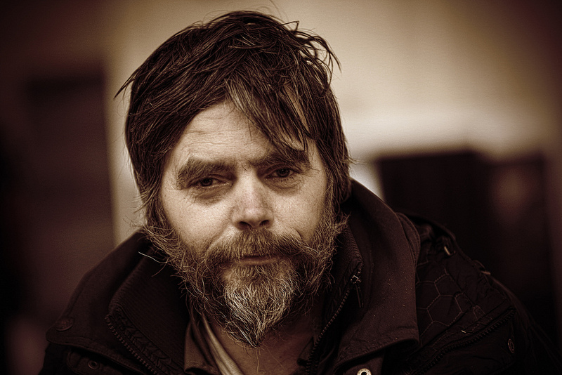
TIC - for volunteers
Why this presentation
Trauma, neglect and attachment
Working in a trauma informed way as a volunteer
Looking after yourself too
Top things to remember
Q&A
In this presentation…

Slide 3
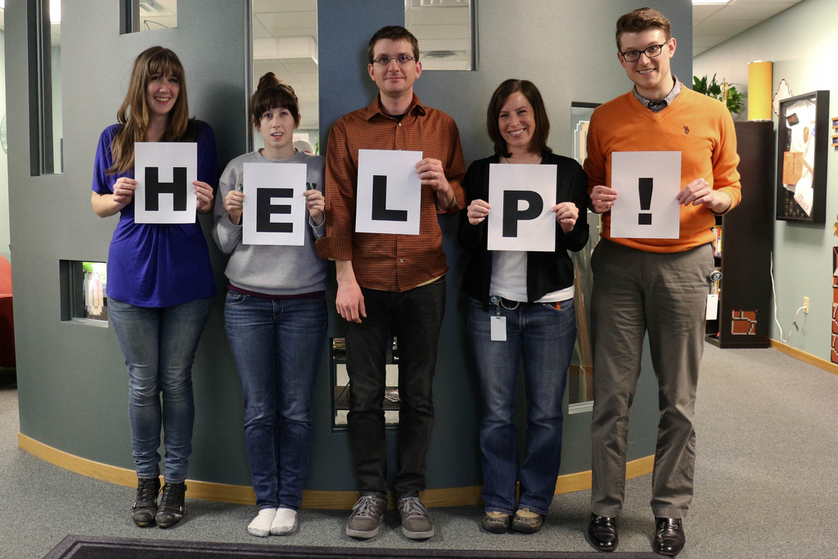
Why learn about this?
We all like to feel that we are helping someone
But sometimes there is a possibility that we can disempower those we are helping
Learning about the underlying reason why someone may be homeless can help us to understand their needs
This helps us to provide safe, supportive relationships and environments
We also need to take care of ourselves
Notes:
This wont relate to everyone you come across in your work but it is better to keep this in mind

Slide 4
Trauma and Homelessness
Research has found that:
Experiencing trauma can lead to homelessness, losing your home can be traumatic and being homeless can be traumatic
Goodman et al (1991)
There is a strong link between homelessness and complex trauma (trauma in early childhood).
Nick Maguire et al (Southampton Uni)
85% of those in touch with criminal justice, substance misuse and homelessness services have experienced trauma as children.
Lankelly Chase Foundation, (2015)
Historic service provision; shelter/housing, food, clothes
Services are now working in a more therapeutic way

Slide 5
What is trauma?
An event which leaves a person feeling HELPLESS and TERRIFIED: lack of control/unpredictability, loss of safety, fear of serious harm/death
Defined by the experience of the individual NOT the event
Not everyone that experiences trauma will develop chronic symptoms. This will depend on their RESILIENCE
Early childhood trauma has more of an effect than only experiencing trauma as an adult
SHP

Slide 6
Complex trauma
Prolonged or multiple trauma (abuse/neglect) usually from caregiver in early childhood
Profound lifelong effects – physical health, mental health and social
Common among people with mental illness, prison histories, suicide attempts, eating disorders, drug and alcohol addictions
Likely to continue experiencing trauma into adulthood and throughout life

Slide 7
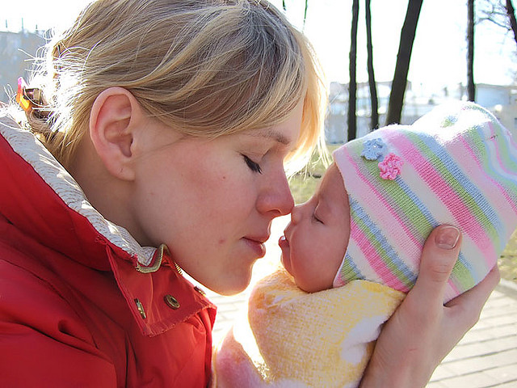
Attachment Theory
From birth we learn how to relate to others and the world through our caregiver
We are also taught to understand our own emotions and how to control them
Many things are gained through this relationship which are crucial for a functioning personality
If all is well, the child develops a ‘secure’ attachment and is unlikely to have further issues

Slide 8
Attachment Theory
If the caregiver is unavailable or abusive an individual may not learn:
How to feel safe/secure in self and with others
The difference between intimacy and sexual contact
To understand facial expressions or how to gage emotions in others
How to understand and deal with their own emotions
Confidence, self worth
How to engage socially
How to appropriately get their needs met
SHP

Slide 9
Insecure attachments as adults
People with an insecure attachment may think that:
Others cannot be trusted or want to hurt them
The world is dangerous
Life is unfair
Life has no meaning
They have no control or power
They need to be on guard all the time
They are a bad person and the abuse was their fault
They cannot protect themself
They are unlikely to feel a sense of SAFETY or CONTROL within themselves, with others, and with the world
SHP

Slide 10
Aims of Trauma Informed Care?
Increase safety
Increase control
Increase understanding
Increase empathy
Enable recovery to begin
Decrease risk of secondary trauma
Decrease likelihood of retraumatisation
SHP

Slide 11
The thinking of a trauma-informed support provider:
What has happened to you? NOT
What is wrong with you?
How can I make you feel more safe?
How can I make the environment safe?
Amicus Horizon

Slide 12
Creating safety
Building a therapeutic relationship:
Friendly, but not friends
Authentic, honest and fair
Respond to their need within the relationship
Empathic
Consistent and stable
Being clear of your role
Active listening
Creating a safe environment
Non-judgemental
Validate their actual emotions and feelings
Be aware and honest about what you can/can’t do, know/don’t know
Strong role model
BOUNDARIES
SHP

Slide 13
Boundaries
Do…
Role model good boundaries: how to act, what to share, what to say, how to respond, how close to be to someone
Be clear about your role:
‘I am here to….I will…..’
Provide support within the boundary of your role
Treat everyone the same
Work with your team to address issues and signpost to specialists
Don't…
Forget your role and position of power
Treat any guest differently
Meet up with guests outside of your official volunteer role
Give away personal details e.g. phone number
Deal with an issue by yourself or collude with a guest
Give or accept money or other items
SHP

Slide 14
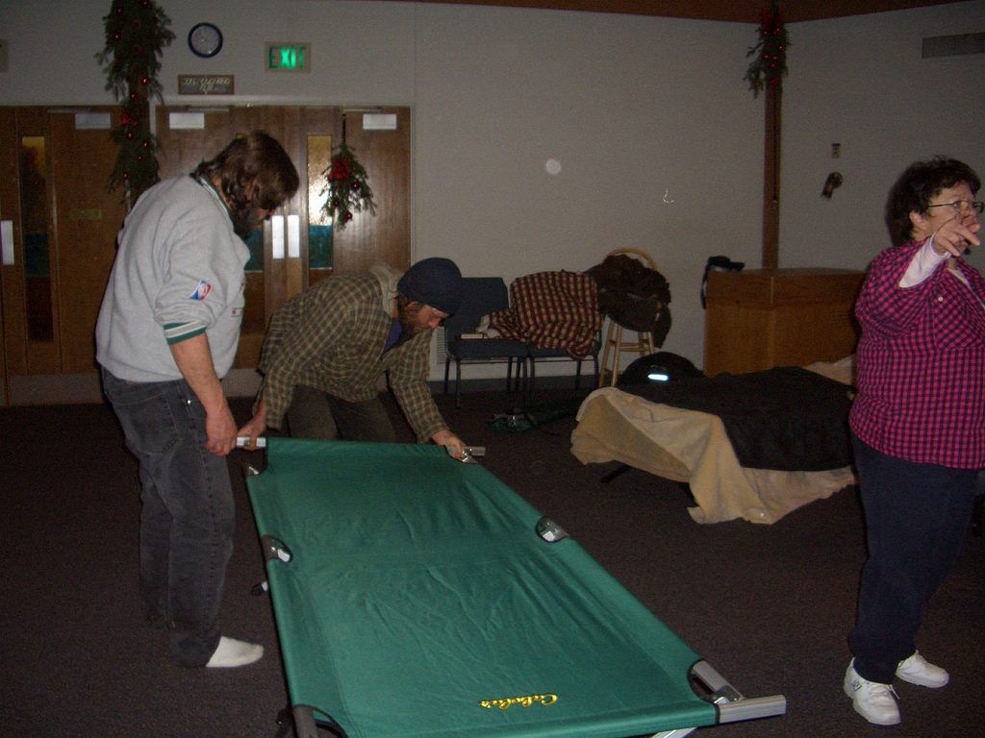
Creating safe environments
Clear policies and procedures (and rules) allow people to understand what is expected of them and what they can expect of others
Enable staff to keep the environment safe
Support people to feel safe and, in knowing the rules, people are unlikely to feel out of control
Ensure you work as a team to keep the environment safe by following policies and procedures and supporting clients to follow the rules
SHP

Slide 15
Things to be aware of
As children, people who experience abuse or neglect may not have had their needs met by their caregiver. For this reason the child has to adapt to survive
Having developed other coping mechanisms as children, an adult may still use these without realising it
This could be; lying, ‘manipulating’ or becoming angry or upset
Be mindful of this and work in a team to meet the needs whilst modelling appropriate behaviour and language
SHP

Slide 16
Some clients will have experienced people pushing or violating their boundaries before or may act or speak in ways we find uncomfortable. We need to keep them and ourselves safe and be a consistent and stable person for them.
SHP

Slide 17
Fight or Flight?
Autonomic nervous system is triggered when we feel fear/threat (fight, flight, freeze)
Dis-regulated as a result of early childhood trauma or neglect – people may quickly become hyper/hypo aroused
May not have the knowledge to understand their emotion and/or how to control it
What has made them feel unsafe?
Check in with yourself too
Amicus Horizon

Slide 18
Challenging behaviour
When fight/flight system is triggered the person can become overwhelmed with the emotion
They may be feeling hyper-aroused (highly anxious, stressed or aggressive) or hypo-aroused (withdrawn and numb)
They may use coping strategies to deal with the emotions; drugs/alcohol, self harm, lying, lashing out, shouting or being threatening
Understand this and validate their emotion
Work as a team
Be consistent
Be assertive not aggressive
Do not assert your authority
Ask them what they need from you
SHP

Slide 19
Scenarios
During the night one of the guests tells you that he feels suicidal. He does not want to speak to his caseworker about it because he is scared that they may try to have him taken into hospital
Listen empathically and remain calm
Keep chatting, you can’t make it worse
Let him know that as a volunteer you always need to tell your supervisor
Explain why this is -because he is at risk to himself and you are concerned
SHP

Slide 20
Scenarios
A shelter guest asks if he can have your phone number to let you know about a housing appointment he has the next day
Politely explain you are unable to give personal details to guests
Say he can tell you about it the next time you are there
Encourage him to let a paid member of staff know
SHP

Slide 21
Scenarios
You are waiting at the bus stop on your way home and one of the shelter guests asks if you could lend her the bus fare so that she can go to a GP appointment. She promises to pay it back to you next week.
Encourage her to return to the shelter/centre as they may be able to provide the fare
Do not give money yourself
Explain that you are not able to give money
SHP

Slide 22
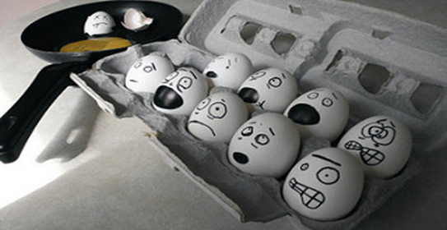
Looking after No. 1
Working in homelessness services can be DRAINING!
Service providers can experience ‘secondary trauma’ – which leads to burn out
Feeling hopeless, depressed, stressed, uncreative, frustrated etc
Ensure you look after yourself – ask for support if you need it, do things you enjoy, make sure your basic needs are met, trust your gut
Amicus Horizon

Slide 23
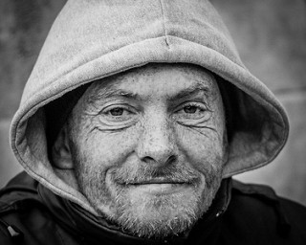
Top things to remember
Look after yourself!
We need to make service users feel SAFE and EMPOWERED
Work within the boundaries of your role to make people feel safe
Work as a team to provide a consistent and predictable service
You’re not here to heal or help, you’re here to support and empower
Amicus Horizon

Slide 24
Questions?
More Information:
Jo Prestidge
joanne.prestidge@homelesslink.org.uk
020 7840 4420
@joanneprestidge

