Slide 1


Working Together with the DWP
Homelessness Presentation 2018

Slide 2
Introduction
This presentation was created by Homeless Link for use by our members in delivering Working Together events that bring together homelessness and DWP teams to improve service deliver to people experiencing homelessness

Slide 3
Who is homeless? The people we work with
34%
have mental health issues
7/10
are male
44%
are young people
32%
multiple needs
1 in 5
Offending history
26%
have drug problems
Source: Homeless Link Annual Review 2017

Slide 4
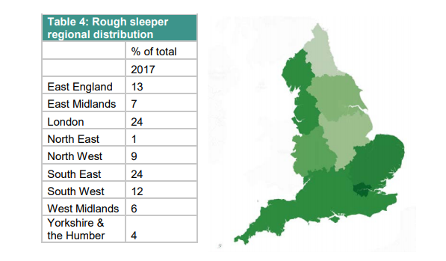
Rough sleeping – regional context
In terms of overall distribution of rough sleeping across England, London and the South East reported the highest number of rough sleepers, with the North East reporting the lowest numbers
Source: Homeless Link Annual Review 2017

Slide 5
Rough sleeping – national context
Source: Homeless Link Annual Review 2017

Slide 6
Statutory homelessness – national context
Source: Homeless Link Annual Review 2017

Slide 7
Service pressures
39% of accommodation providers reported decreased funding in the past 12 months (47% in 2016)
National Audit office reported 59% reduction in Supporting People (housing-related support) funding since 2010.
Yet high levels of demand
37% of responding providers (94 respondents) reported operating at full capacity the previous night. 40% reported having 1-10% voids the previous night (mostly 1%).
A lack of service capacity was most commonly identified as the primary reason for refusing service access (35%). 59% identified it as a reason
Likely to be unmet need among some single homeless people
Source: Homeless Link Annual Review 2017

Slide 8
Universal Credit
Historical problems for people experiencing homelessness
Paid into bank account (lack of ID, confusion around Post Office Accounts)
Claim online (lack of IT facilities and support, long passwords, Universal Support?)
Delay for first payment (evictions, barrier to tenancies, debt)
Deductions from benefit (arrears, overpayments, paying back Advance payments)
One ‘large’ payment a month (hard to budget, substance misuse, ‘targeting,’ accessing APA’s, Universal Support?)
One benefit unit per family (financial abuse)
Implicit/Explicit consent (communications, escalation, advocacy)

Slide 9
Sanctions – impact on people experiencing homelessness
Homeless Link research found that homeless people on Jobseekers Allowance (JSA) were around ten times more likely to be sanctioned than the general claimant population.
Many examples of claimant commitments / conditionality requirements not being tailored to an individuals circumstances
Generally, people experiencing homelessness do not meet particular conditionality requirements as they are unable to, rather than they do not want to comply
  No access to a phone
  No access to travel fares
  Lack of a regular postal address
Lack of awareness amongst JCP and homelessness agencies around Homelessness easement
Identification a key issue; claimants reluctant to disclose certain information unless the right conditions in place (appropriate setting, rapport with work coach)

Slide 10
Accessing work – challenges for people experiencing homelessness
80% of people experiencing homelessness want to work, but only 10% are in employment
Barriers can include:
  lack of experience, poor qualifications and low levels of basic skills
  unstable housing situations
  substance use, mental health, domestic violence, offending histories and institutionalisation
  low confidence, low self esteem and aspirations
  difficulty in relating to other people, fluctuating health conditions
  the stigma of homelessness
  a lack of access to computers and the internet
Challenges for the Work programme / JCP employment support / Specialist Employability Support
  Identifying people entitled to support through the Work programme
  Identifying barriers individuals face
  Support provided by the homelessness sector effectively complimenting work provided by JCP/Work Programme/Specialist Employability Support

Slide 11
Working Together with the DWP
1
Employment is the homelessness sector’s priority too
2
Support planning in homelessness services aims to move clients forward and recognises the client’s distance travelled
3
Develop partnerships with local services, know what they do and the support they offer
4
Identify and assess the needs of those experiencing homelessness

Slide 12

Working Together – Discussion 1
1
What does a successful partnership look like?
2
Where have you seen partnership working work well?
3
What do you need to make a partnership successful?

Slide 13

Working Together – Discussion 2
What are you going to do next to develop partnerships locally?

Slide 14
Working Together – Feedback
1
Give an example of good practice
What will you do next to develop partnerships locally?
2
3
Give one piece of information you will take away from today

Slide 15
What we do
Homeless Link is the national membership charity for organisations working directly with people who become homeless or who live with multiple and complex support needs. We work to improve services and campaign for policy change that will help end homelessness and secure a sustainable future for supported housing.
Homeless Link
Minories House, 2-5 Minories, London EC3N 1BJ
020 7840 4430
Twitter: @Homelesslink
Facebook: www.facebook.com/homelesslink
© Homeless Link 2018. All rights reserved.
Homeless Link is a charity no. 1089173 and a company no. 04313826.

