Slide 1
Voluntary Community and Social Enterprise (VCSE) sector and Integrated Care Systems
Presented by Carrie McKenzie, Voluntary Partnerships Senior Manager, Voluntary Partnerships Team.

Slide 2
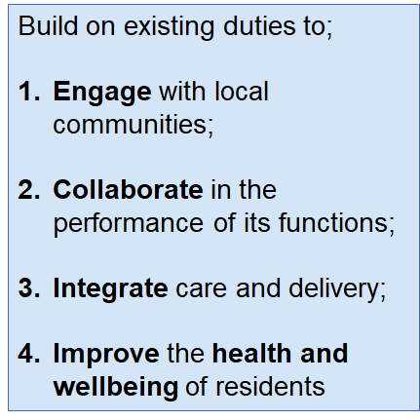
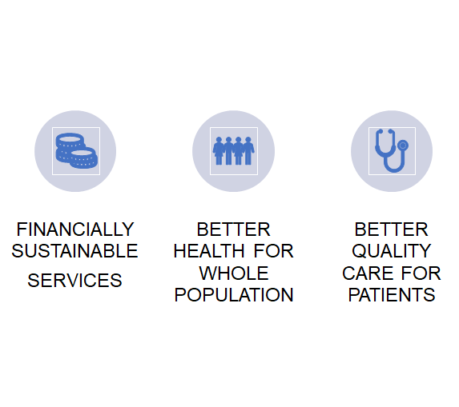
Strategic Context
NHS Long Term plan (2019) and White Paper (2021): Working together to improve health and social care for all
Triple Aim

Slide 3
Voluntary Partnerships Team
Responsible for developing and maximising the contribution that the Voluntary Community and Social Enterprise (VCSE) sector and volunteering plays on NHSEI programmes and activity across national and regional programmes, workstreams and integrated care systems.
NHS Long Term Plan Commitments and ICS Design Framework | We will achieve this by
A formal agreement in place for engaging and embedding the VCSE sector in system level governance and decision-making arrangements | Delivering and rolling out a national development programme
To continue to commission, partner with and champion VCSE | Facilitating the spread and scale of innovative practice and effective partnership working
NHS England Principles for VCSE Engagement

Slide 4
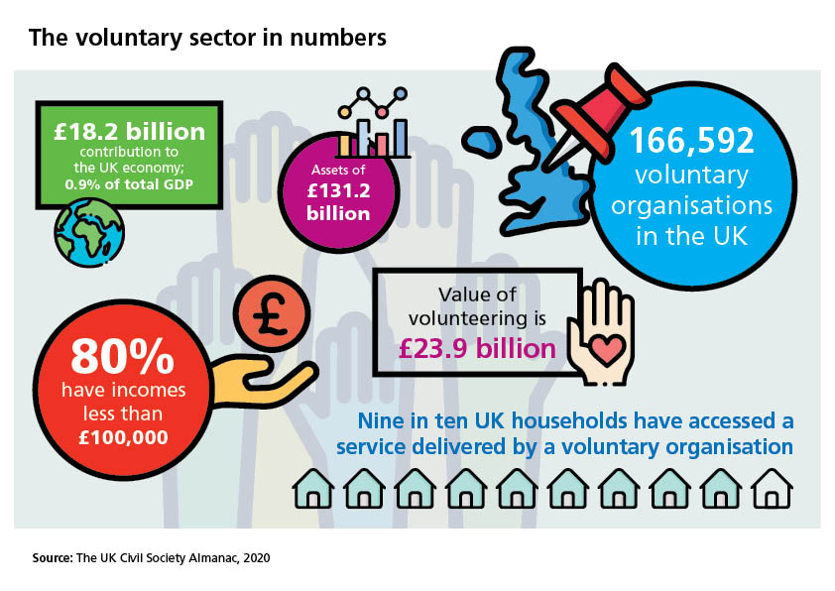
The scale of the VCSE sector in the UK
166, 854 registered voluntary organisations
100,000 Social Enterprises (source SEUK 2018)
£18.2 billion contribution to UK economy
£23.9 billion of formal volunteering
2 million employees
£140 billion
of Assets
90% UK households have accessed a voluntary sector service
Employs 910,000 people (approx. 2.8% UK workforce
Worth £24 billion
Source: NCVO Almanac 2020
NB: this data does not include unregistered community groups
Notes:
Workforce
The sector employs approximately 910,000 people, about 40,000 more than in 2018
About 910,000 people worked in the voluntary sector in the UK in June 2019, equivalent to 2.8% of the UK workforce.
Compared to 2018, there was a small decrease in the number and proportion of people working in the voluntary sector. This was in contrast to small increases in the numbers working in the public and private sectors. In 2019, the public sector employed 7.1 million staff and the private sector employed 24.3 million staff.
For comparison, the voluntary sector workforce is just under three-fifths of the size of the NHS workforce, (the single largest employer in the UK with a headcount of around 1.5 million) and more than two and a half times that of Tesco’s workforce (one of the largest employers with 344,000 staff in 2019).

Slide 5
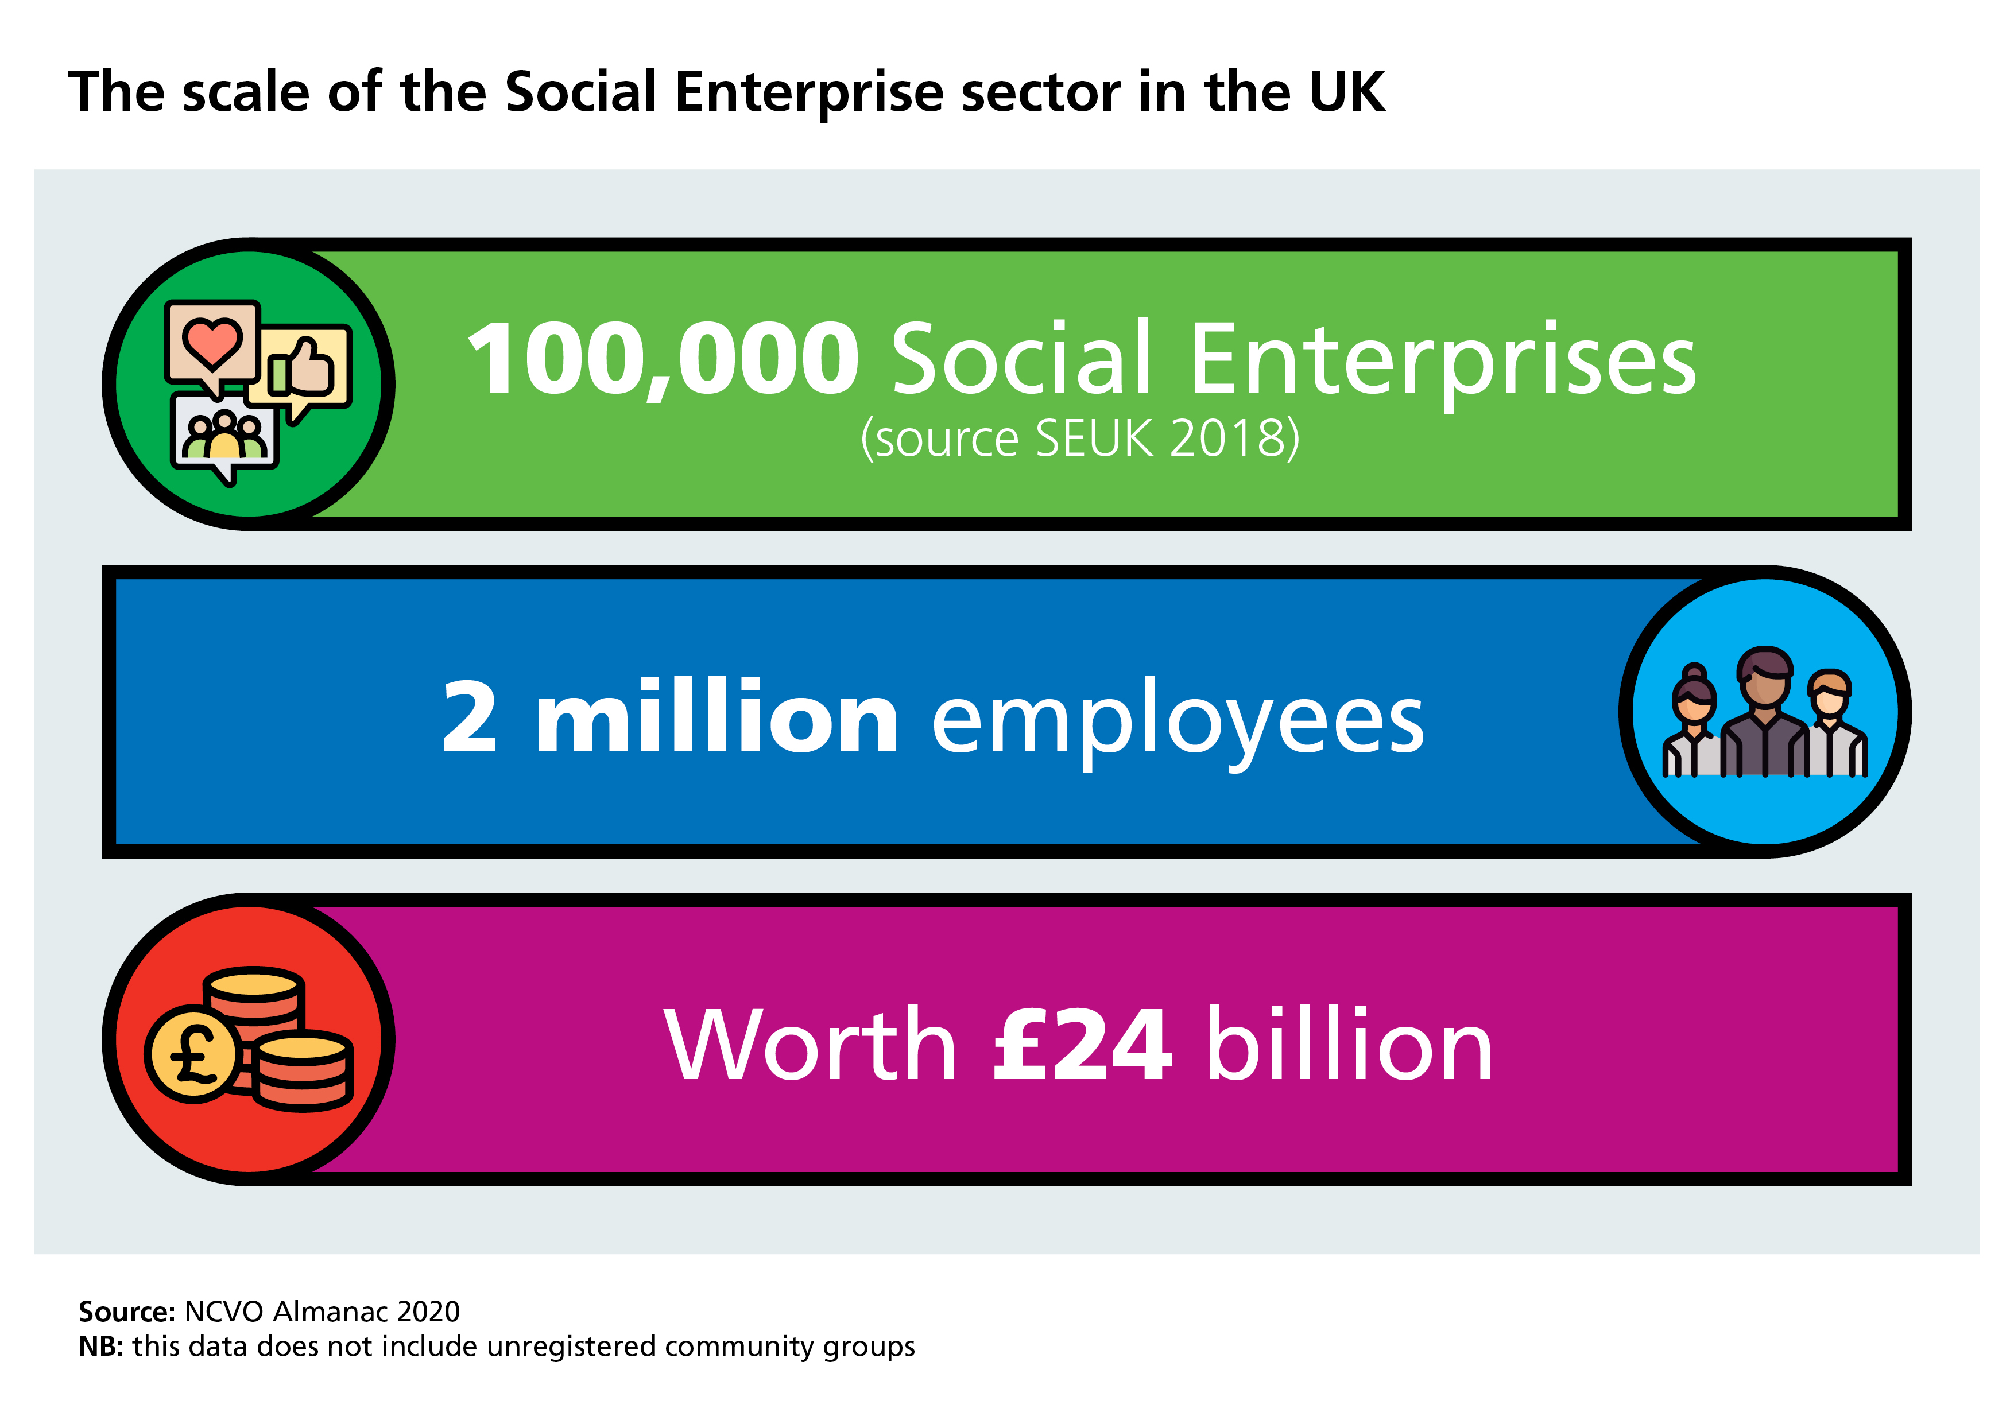
Notes:
Social enterprises provide a third of community care, and 67% out of hours care services are currently provided by social enterprises along with a host of other services including dentistry and audiology. They are financially viable (96% of social enterprises delivering health and care services made a surplus last year) and, on average, are rated Good to Outstanding by the Care Quality Commission (CQC).

Slide 6
Why partner with the VCSE sector
It is diverse offering a wide range of services and approaches and makes up a significant proportion of health and care workforce
Provides reach into different communities and groups (condition, geography and protected characteristics)
Valuable - bringing assets, insight and investment into systems
Flexible and agile – can respond quick and adapt to need
Innovative and creative – have the freedom to think and act differently
Provides Value for Money

Slide 7
Future of Integrated Care Systems
There are 42 Integrated Care Systems (ICSs) are partnerships to which have four fundamental purposes:
Improving population health and healthcare
Tackling unequal outcomes and access
Enhancing productivity and value for money
Helping the NHS to support broader social and economic development
This involves the following changes:
Stronger partnerships in local places between NHS, local councils and others such as employers, education, housing and VCSE sector
System-wide strategic commissioning with a focus on population health and reducing health inequalities (CCGs will no longer exist)
You can find out more about your ICS here.
Watch this clip explaining the North East and North Cumbria ICS

Slide 8
Integrated Care System Structure – April 2022 onwards
Neighbourhoods: Populations up to 50,000
Brings together Primary Care Providers (PCNs) – GP, Dentist, Pharmacy, Opticians and community services into Primary Care Networks (PCNs)
Social Prescribing and Asset Based Community Development
Population Health Management and health promotion
Place: Populations between 250,000– 500,000
Partnerships between the NHS, local government and other system partners working together in a locally defined ‘place’ to collectively plan, deliver and monitor services. May be part of a Health and Wellbeing Board or separate
Supporting design, delivery and development of new service model
Reducing Health Inequalities and supporting prevention
Focusing on the integration of services
System: Populations over 1 million
Integrated Care Board (ICB)
New statutory organisation leading integration within the NHS, bringing together all those involved in planning and providing NHS services. Subsumes the role of Clinical Commissioning Groups
Integrated Care Partnerships (ICPs)
Forums bringing together partners across the system responsible for developing overarching strategies that cover health, social care and public health and address the wider determinants of health and wellbeing.

Slide 9
Role of VCSE in Integrated Care Systems
The VCSE sector is a vital cornerstone of a progressive health and care system. ICSs should ensure their governance and decision-making arrangements support close working with the sector as a strategic partner in shaping, improving and delivering services and developing and delivering plans to tackle the wider determinants of health. VCSE partnership should be embedded as an essential part of how the system operates at all levels.
This will include involving the sector in governance structures and system workforce, population health management and service redesign work, leadership and organisational development plans.
NHS England ICS Design Framework pg. 28-29
NHS England Guidance on partnerships with the VCSE sector
Watch this video – North East and North Cumbria ICS

Slide 10
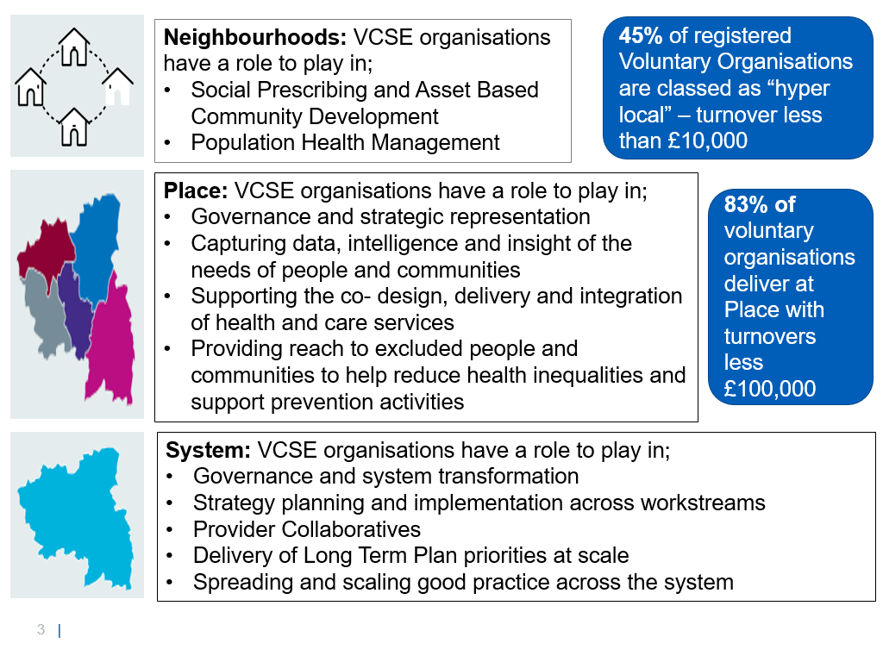
Role of VCSE in Integrated Care Systems
The VCSE sector is an essential system transformation, innovation and integration. The sector supports communities of place, identity and experience and plays a key role in;
designing and delivering services and integrated care – using intelligence, insight and innovation
reaching into and often amplifying the voice of different communities and groups
helping address health inequalities – particularly for groups with the poorest health and the most marginalised
VCSE Leadership programme
Supports the development of diverse and inclusive VCSE partnership and networks at place and system level.
Programme will be offered to all ICS’s in 2021/2022

Slide 11
Moving Forward: Embedding VCSE sector in Integrated Care Systems
“We expect that by April 2022 Integrated Care Partnerships and the ICS NHS body will develop a formal agreement for engaging and embedding the VCSE sector in system level governance and decision-making arrangements, ideally by working through a VCSE alliance to reflect the diversity of the sector.”
Pg. 28-29 ICS Design Framework

Slide 12
National Development Programme
Embedding the VCSE in ICS
Aim:
Continue the roll out of the VCSE Leadership programme to all ICSs, providing resource and facilitation support to develop system level VCSE Alliance/Leadership group in ICSs.
These VCSE alliances or groups:
Encourage and enable the sector to work in a coordinated way;
Provide the ICS with a single route of contact and engagement with the sector and links to communities;
Better position the VCSE sector in the ICS and enables it to contribute to the design and delivery of integrated care and have a positive impact on heath priorities, support population groups or reduce health inequalities.

Slide 13
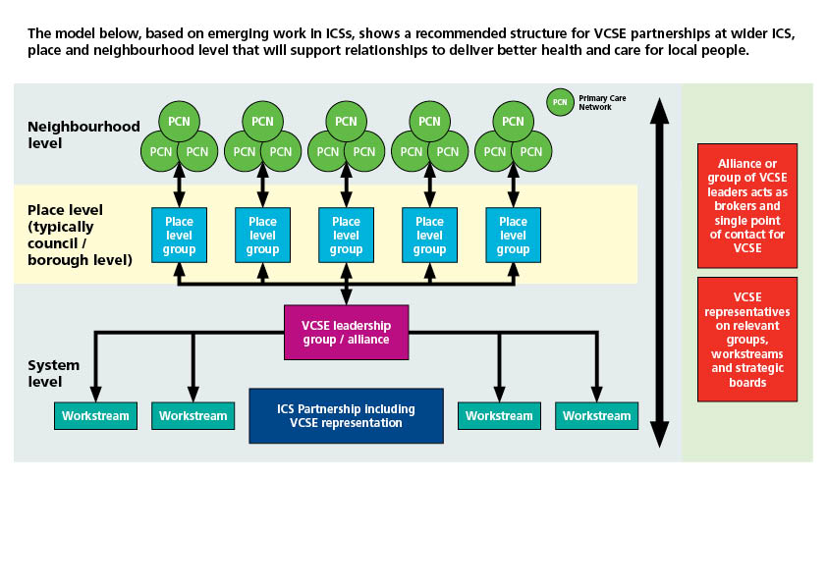
Model for VCSE strategic engagement

Slide 14
Spotlight on North West London
NWL
Neighbourhood
Borough
Tier 3: Developing our leadership and embedding in NW London ICS structures
Tier 2: Developing local leadership and improving sector engagement with ICPs
Tier 1: Taking a neighbourhood focus and engaging and subcontracting 3rd sector with PCNs
What is really good about the way this is working is that it’s not just about the strategic decision making. It’s about bringing the richness of the VCSE sector at all levels.”
Head of Prevention at an ICS

Slide 15
Not just a talking shop!
Partnership in action alongside strategic development:
Improved health outcomes for people:
• High Intensity users
• Out of Hospital community support
• Social prescribing
Capacity of VCSE boosted by being a funded delivery partner
• £1.2 million from acute sector in VCSE in Hillingdon for out of hospital care.
Saves the ICS money
• 250 K from High Intensity User project
New collaborative approach
Third Sector Together – North West London. Find out more Charity 3st | Third Sector Together (North West London) (3stnwl.org.uk)

Slide 16
Getting ready for ICS’s
Continue delivering and working with partners in your local area - ICSs will work on the principle of subsidiarity, with a specific focus at “Place level”.
Reach out to other VCSE organisations in your area. In many areas there will be a VCSE Leaders group or join a local VCSE infrastructure organisation (LIOs, or Councils for Voluntary Services/Voluntary Actions). The umbrella organisations provide support and leadership for the local VCSE sector. NAVCA’s Find a member (navca.org.uk) site lists LIOs for all areas.
Sign up to our Working in partnership with the VCSE sector Future NHS Collaboration platform to find out more about our work and to share knowledge, experience and ideas.-england@voluntarypartnerships@nhs.net

Slide 17
Resources
NHS England Building Strong Integrated Care Systems everywhere: Guidance on developing partnerships with the VCSE sector.
NHS Confed August 2020 “How health and care systems can work better with the VCSE sector”
NCVO “Creating partnerships for success”
Understanding the VCSE (West Yorkshire and Harrogate ICS)

