Slide 1
Homelessness and Mental Health –
What is the need?
Dr Jo Brown
Research Manager
@JoMichelleBrown
16 September 2021
London PLUS Event

Slide 2
Prevalence of mental health issues
People experiencing homelessness have much higher rates of mental health need.
44% of people experiencing homelessness have a mental health diagnoses, in comparison with 23% of the general population (Homeless Link, 2016).
People experiencing homelessness are three and a half times more likely to die by suicide than the general population (Crisis, 2012).
Serious mental health issues such as schizophrenia, bipolar and post traumatic stress disorder (PTSD) are far more common amongst homeless people (Homeless Link, 2014).
People experiencing homelessness often face multiple disadvantage meaning they have two or more interconnecting experiences of homelessness/insecure housing, mental ill health, substance use or contact with the criminal justice system.

Slide 3
Links between homelessness and mental health
Mental health and homelessness are significantly linked - as a person’s housing becomes more stable the rate of serious mental illness decreases (Crisis, 2009).
80% of people experiencing homelessness in England report having mental health needs with more than a quarter citing mental ill-health as the reason for being homeless (Homeless Link, 2014)
Research into unsuitable temporary accommodation found 88% per cent of respondents reported experiencing depression (Crisis, 2018).
6 out of 10 homeless service users classify as ‘lonely’, three times the proportion of over 52s in the UK, a group most associated with being most lonely in society (Crisis, 2015).

Slide 4
Accessing mental health support
People experiencing homelessness face significant barriers when accessing health services, especially primary care.
The barriers to accessing services are more difficult when someone is also actively using substances.
Homeless Link (2014) found that people that are homeless attend A&E 6 times more often, get admitted to hospitals 4 – 8 times more, and once admitted, stay 3 times longer than the general population.
When engaging with healthcare services, often people have a poor patient experience, which is the focus of the following research. This can lead to people disengaging or a lack of trust.
The pandemic has led to a significant shift in the way services are delivered.

Slide 5
Break-out discussion
What are the main challenges for people experiencing homelessness when maintaining their mental health and wellbeing?

Slide 6
#HealthNow research – what we did
Our aim was to “Identify barriers to people experiencing homelessness, accessing care and treatment at a local level, in three key partner cities and develop action plans to eradicate those barriers”.
Peer researchers carried out semi-structured interviews with 164 people experiencing homelessness in Greater Manchester, Newcastle and Birmingham.
Three local reports and action plans were devised to ensure changes to the system and good practice could be used to inform change locally.

Slide 7
#HealthNow research – what we heard
#HealthNow research illustrated that mental health and wellbeing was the most significant health priority for the majority of people we heard from.
However, mental health services were also rated the lowest across all three areas.
Mental health issues, loneliness and isolation have been exacerbated by the COVID-19 pandemic.

Slide 8
What we heard – key issues
It was hard to access to mental health support and transitions and discharge between services could be disjointed (including when leaving criminal justice system or moving from local area).
“I've been with the mental health team for 5 years. I had counselling to begin with and then after a couple of months of counselling they signed me off and said my mental health was fine. Then I had another breakdown earlier this year (April/May) and I was rereferred to counselling. I'm still on a waiting list and I haven't heard anything. They've just told me to go to my GP in the meantime. This isn't good if I'm feeling suicidal”.

Slide 9
What we heard – key issues
There were concerns around the interaction between inappropriate housing and mental health and wellbeing.
“There were times when I felt despondent, seeing a guy at the hostel who was still there when I was. He’d never received proper mental health care and his mental health had deteriorated. I felt like he would be forever homeless”.

Slide 10
What we heard – key issues
It was harder for people to access support when they had concurrent mental health issues and substance use issues.
“When it comes to doctors right, they won’t touch people with addiction that are still using drugs, because they think well their mental health – basically they won’t help people with mental health when they’re on drugs, because they think right, their mental health’s bad because they’re on drugs, when they don’t think maybe this person uses drugs because of their mental health; they’re treating themselves because we won’t help them. And that’s exactly what I feel”.

Slide 11
What we heard – impact of COVID
The most common theme identified by people when discussing the impact of the pandemic on their lives was the detrimental affect it had on their mental wellbeing and their increased feelings of social isolation.
“Struggling with depression, panic attacks and loneliness. The current situation with COVID-19, not being able to go out coupled with having cancer has heightened [my] fears and anxiety which has led to panic attacks and feelings of emptiness”.
“COVID-19 has also made me feel alone. you feel you don't have anyone. You have to think of your case, your health. You feel stressed and life doesn't feel the same anymore and you feel you have no support”.

Slide 12
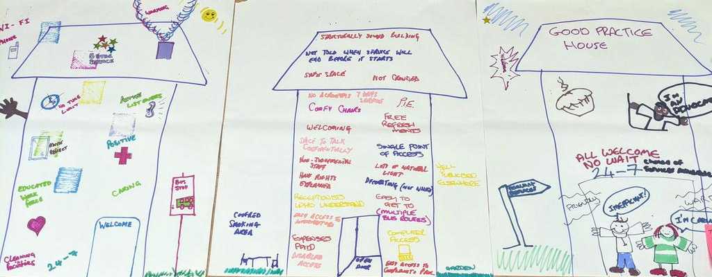
Next steps
We are carrying out thematic research to better understand these issues, with a specific focus on:
Access to mental health services and support
What works and what do people want?

Slide 13
Next steps
Can you help?
If you would be interested in talking to us about your experiences of working with people experiencing homelessness and mental health issues?
If you work with people who would like to talk with us who have experience of homelessness and mental health issues?

