Slide 1
Bridging the Health Gap
Holding conversations about health:
A workshop for homelessness sector organisations.

Slide 2
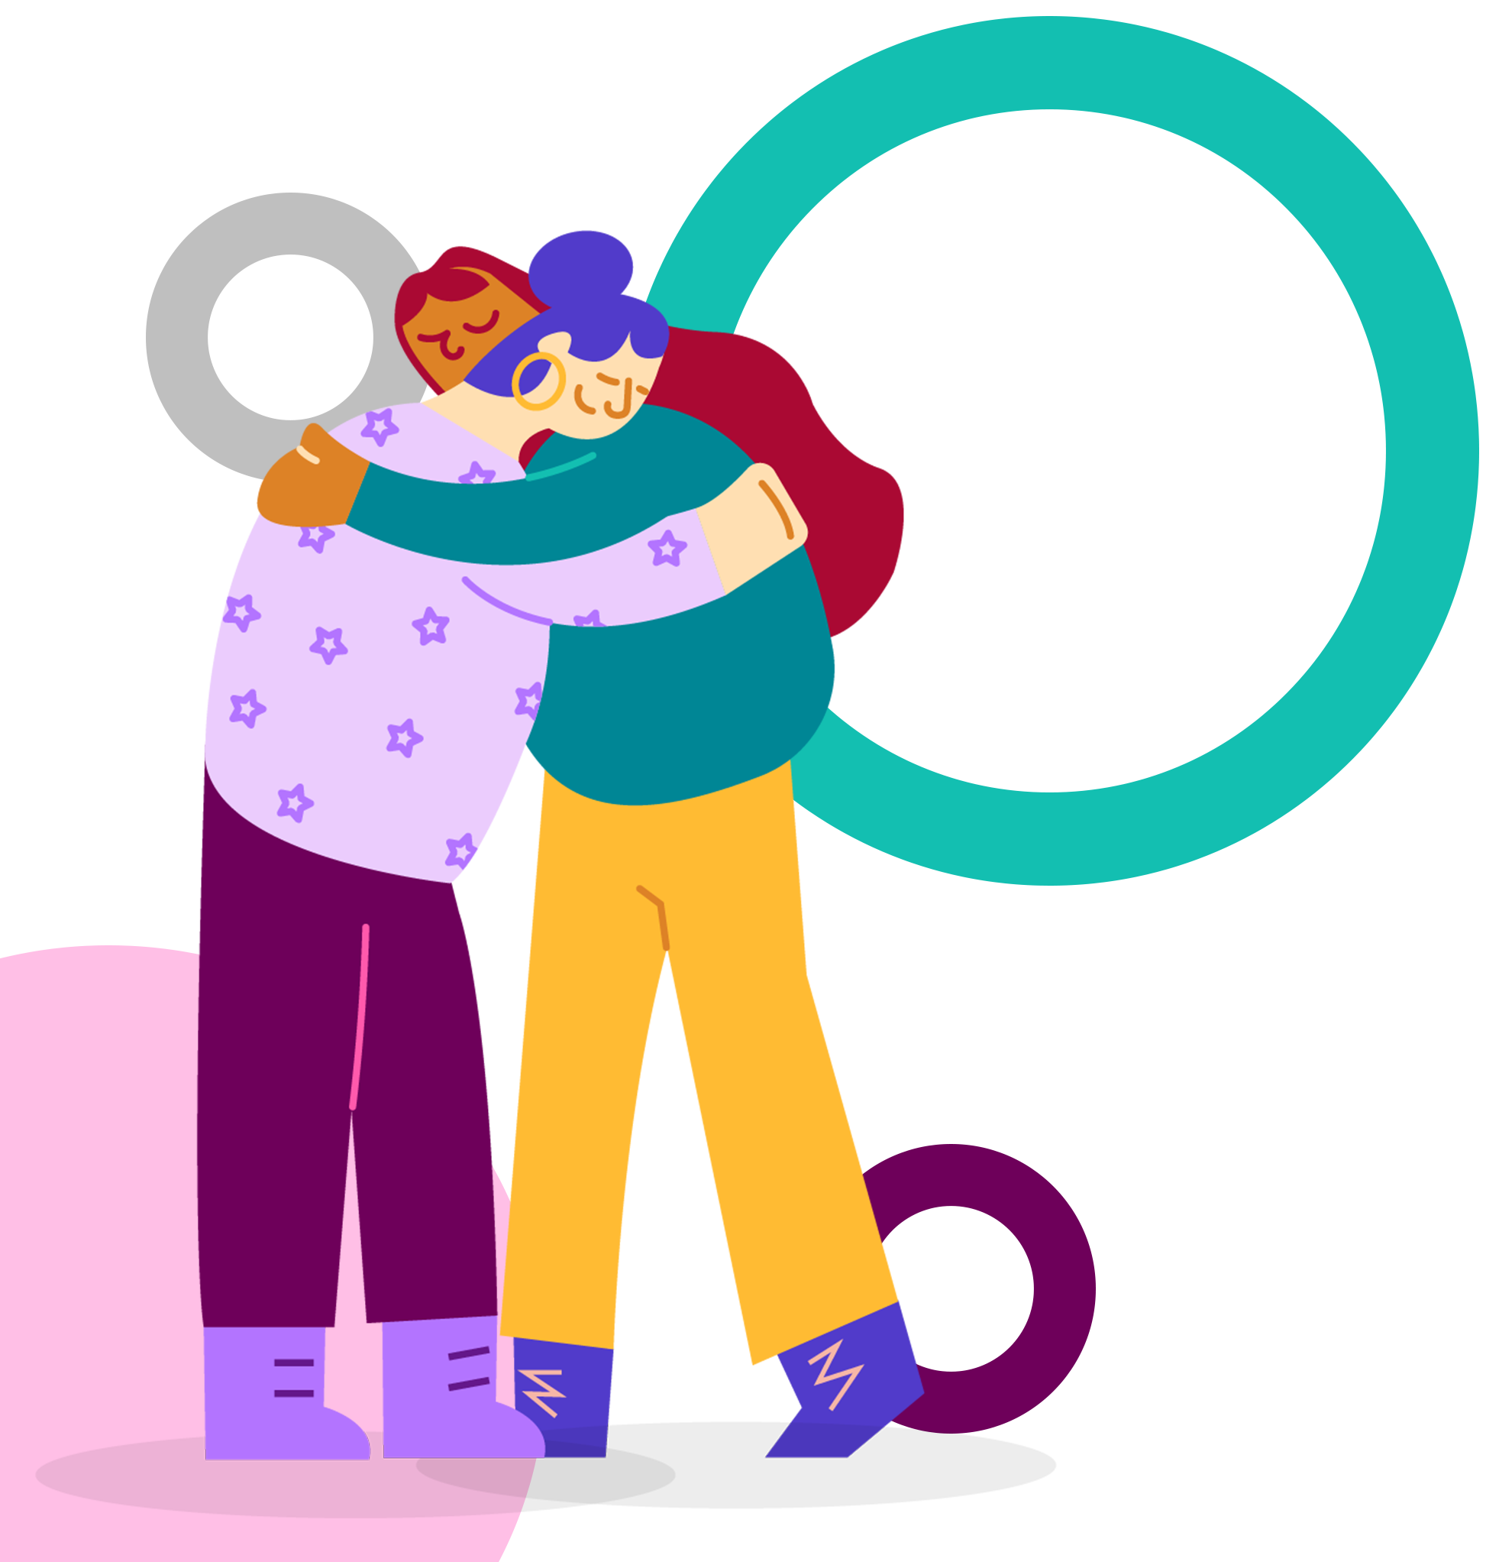
Introduction
Why are health conversations important?
People experiencing homelessness have some of the worst health outcomes and rely heavily on emergency medical care.
The average age of death for a homeless woman is 41.6 years compared to 45.9 for men (ONS, 2021).
People who are homeless are 9x more likely to take their own lives.
The prevalence of Tuberculosis is 34x higher than in the general population.
The prevalence of heart disease is 6x higher than in the general population.

Slide 3
Introduction The role of homelessness support workers
Homelessness workers play a key role in encouraging people to engage with more upstream health care.
Homelessness workers spend a lot of their time supporting people with health and social care needs.
Conversations initiated are typically focused on emergency health care needs.
Staff have the skills but may lack confidence to have more general health conversations.

Slide 4
Introduction Myths about access to health services
MYTHS | FACTS
You have to have an address to register at a GP. | If an individual has no fixed address/is homeless, they are entitled to register for a GP using either a temporary address (a day centre, friend’s address) or use the address of the GP.
You need ID to register at a GP. | GP Practices have a responsibility to register people who are unable to provide ID or documentation to indicate them living in a particular area.
You have to have status in the UK to access free NHS health care. | All primary health care (including: GP services, primary dental treatment, A&E etc.) as well as testing, treatment & vaccination against COVID-19 is free for everyone, regardless of immigration status.

Slide 5
Introduction Exercise – what is good health support: instructions
Think of a time when you have had a positive experience of seeking support around your health.
This may be from a professional, friend or family member.
Spend 3-5 mins thinking and writing.
Write down some of the features that made this experience a positive one.
Spend 5 minutes sharing the features.

Slide 6
Introduction Exercise – what is good health support: feedback
Hear feedback from the group.
Write a list of feedback.
How many of these features require you to have specialist medical knowledge? How many can you deliver yourself as a support worker?
REFLECTION: workers in the homelessness sector have all the skills needed to hold positive conversations around health.

Slide 7
Introduction Exercise – Content & Impact of Health Conversations
As a group, discuss what a conversation about health might look like.
For example, what sorts of questions would you be asking during the conversation?
Discuss what you are trying to achieve by having these conversations.
For example, how might the conversation have a positive impact on that individual’s health outcomes?

Slide 8
Film Clip Less
Less is a film made by people with lived experience of homelessness. It details some of the key moments of their experiences including some of their experiences of accessing health services.
Watch the extract from the film and think about what barriers people experiencing homelessness may face when accessing healthcare services.

Slide 9
Film Clip Less
Watch from 0 mins 25 seconds to 1 min 55 seconds.

Slide 10
Film Clip Discussion
5 minutes
What other barriers might people experiencing homelessness face when accessing healthcare services?
What barriers to accessing healthcare services were raised in the film?

Slide 11
Barriers to accessing healthcare
Stigma
Fear
Previous negative experiences
Lack of address to register with GP (not needed but often demanded)
Lack of fixed address for correspondence
Conflicting priorities: need to find sleeping site, money, food substance misuse etc
Multiple health support needs
Cost of travel to appointments
Waiting times
Lack of confidence
There will be others…

Slide 12
Film Clip Clarissa
Clarissa is a film about a woman experiencing homelessness. It was created to improve the health of people affected by homelessness, through better understanding of their experiences.
The film was made by Groundswell who are a charity that aims to create solutions to end homelessness that come directly from people who have been homeless. They have a strong focus on health and deliver a range of resources including information leaflets, training and a Homeless Health Peer Advocacy service.
CONTENT WARNING
Clarissa explores themes relating to childhood abuse, drug taking and drug dependency. The sections we are watching do not contain these scenes. If you need further support in relation to these issues, please discuss this with your manager.

Slide 13
Film Clip Clarissa
The extract shows some interactions between an outreach worker and the main character.
We are not suggesting that this is good practice.
Watch the clip and think about:
What do you think the outreach worker could have done differently?
What do you think would make a positive health interaction?
Is there anything the outreach worker does well?

Slide 14
Film Clip Clarissa
Watch from 3 mins 40 to 6 mins 20.

Slide 15
Film Clip Discussion
Discussion – 5 minutes
What did you think?
Any general reflections?
What do you think the outreach worker could have done differently?
Is there anything the outreach worker does well?
What do you think would make a positive health conversation?

Slide 16
What makes a good health conversation?
Positive relationship:
Trust and respect built up over time
Person-led:
Listening to what the person wants
Asking open questions
Ask don’t tell
Approach:
Non-judgemental
Respectful
Inclusive:
Using inclusive language
Equal conversation
Self-advocacy:
People make their own decisions
Encourage people to do as much as possible for themselves
You can learn more about Groundswell’s MACCA approach in the resources that accompany this session

Slide 17
Discussion Barriers for support workers
What are some of the barriers that you face in supporting the people you work with to talk about their health/access services?
1
Discuss this in a group of 3-4 people
2
Share with the main group
3
What resources, training, information and support do you need to have more health conversations with the people you work with?

Slide 18
Available resources
Holding Conversations about Health Resources
Lists existing training, information and leaflets on accessing healthcare and different health conditions
Template list of contacts for organisations
Add to and complete for your organisation with contact information of services that you would find useful
Brief introduction to Making All Contacts Count through Advocacy (MACCA)
An approach to holding health conversations designed specifically for homelessness workers
Recorded webinar on approaches to holding conversations about health

Slide 19
What we do
Homeless Link is the national membership charity for frontline homelessness services. We work to improve services through research, guidance and learning, and campaign for policy change that will ensure everyone has a place to call home and the support they need to keep it.
homeless.org.uk
@HomelessLink

