Slide 1


Advocacy and meaningful participation
Chair: David Gill, Homeless Link Associate
Speaker: Selena Bostock, Service Manager - Business and Development, Sea Participation

Slide 2
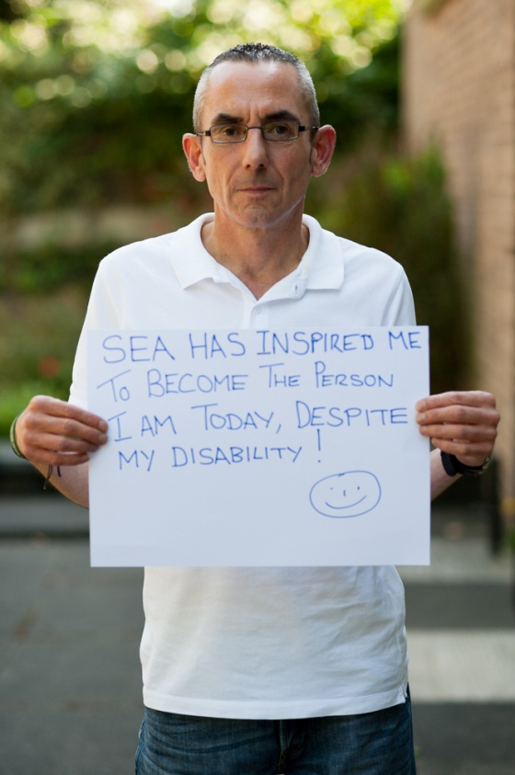

‘Dialogue not confrontation’
Meaningful Participation – The Voice of Lived Experience
Notes:
1 mins SERENA
Introduce session
Volunteers and staff

Slide 3
Areas we will be covering today:
Intro to SEA
What is Advocacy
Advocacy Charter
Why is meaningful participation important?
Real Lives – SEA video
A SEA Perspective – Q & A Panel
Notes:
2 mins SERENA
Run through what we'll be covering.

Slide 4
Who are SEA?
Services for Empowerment and Advocacy give people a voice into Housing, Health and Social Care.
‘Tell me I will forget
Show me I may remember
Involve me and I will understand’
Confucius : 450BC
Notes:
SERENA
5 –10 mins - Bit of blurb about SEA and why we are there.
CIC, Advocacy services to help get the voices of services users heard in housing, health and social care.
Based in Nottingham, work in Derbyshire, Lincolnshire also
Been running since 2004
Offer a unique service, generic independent advocacy service – not statutory, impartial, non-bias
Advocacy 1:1, groups, residents meeting
Participation – evaluation, peer research, working with Nottingham Trent, Uni of Nottingham SW programme. SW students in Nottingham last 7/8 years have been interviewed, assessed and taught by SEA volunteers. Influence the SW sector from the very beginning of the teachings and onwards.
Training opportunities to organisations
Ask volunteers to talk a bit about what they do with SEA and what they get out of it. Next slide shows Organisation structure. Encourage Julie and Jules to speak up.

Slide 5
Organisational Structure
SEA Board
Service Managers
Operations - James Boulter
Business & Development - Serena Bostock
SEA Steering Group
Advocacy & Participation Workers
Jane Shipley | Rae Matthews
Julie Farrell | Phil Hudson
Aaron Freestone
Participation
All team members
Administration & Participation Worker
Renee Parnell
Advocacy Partners, Participants and Volunteers
Notes:
SERENA - 1 MINS
Talk about team and about the steering group and why we have one.
The team consists of:
Board – volunteers with certain expertise to oversee SEA
Steering Group – 5 x SEA volunteers who have an interest in the management and leadership of SEA and have lived experience. They feed ideas, suggestions and feedback from volunteers into the Board and attend specific Board Meetings.
Volunteers – SEA volunteers with lived experience who would like to get involved in participation activities at SEA.
Management team; 1 x Operations – Service Manager & 1 x Business & Development – Service Manager
5x Advocacy and Participation Workers
1 x Administration & Participation Worker

Slide 6
What is Advocacy?
Advocacy is working alongside people to ensure their voices are heard and responded to in an appropriate and timely manner.​
Advocacy is ensuring that individuals /groups of people have a voice into the decisions that affect them.​
Advocacy is promoting choices to people and enabling them to consider
all options before choosing a particular course of action.​
Advocacy is about redressing the ‘power’ balance.​
Advocacy supports people to allow them to self advocate where appropriate.​
Advocacy ensures that people are at the centre of any decisions.​
Advocacy is information.​
Advocacy is working in partnership.
Notes:
SERENA - 2 MINS
Choose 3 or 4 brief points to talk about (Not all).

Slide 7
Notes:
SERENA - 1 MINS
Refer to this briefly
Choose a few to give examples

Slide 8
Why Is Meaningful Participation Important?
Services get a real view of what works and what doesn’t.
Gives people an opportunity to influence
how services do things.
Create a collaborative and co-productive way of working.
Improves working relationships with participants and encourages positive engagement.
Services and organisations become flexible and can adapt accordingly.​
Participation is about offering a diverse array of opportunities for people to get involved​.
Recognising people are experts in their own right.
Improves confidence, self-worth and encourages personal development.
Notes:
RAE
15 mins max
Ask volunteers to input why they think their meaningful participation is important.

Slide 9
REAL LIVES
SEA video
Notes:
Show SEA video
6 minutes

Slide 10

A SEA Perspective
Q&A
Notes:
15-20 mins
RAE
This is the part where questions will be put into the chat so we can vet them and ask appropriate ones.
For the next 20 minutes, you’ll get the opportunity to talk with our volunteers, in which they’ll share their experiences of working with services and you can also ask any (appropriate) questions.
For online sessions please refer to work task sheet.

Slide 11
Thank you!
Notes:
Serena 5 mins – For questions/Feedback/Reflections
Summary and one word typed in the chat about what you think about today please
Any reflections on todays teaching session? Any questions for myself and Rae?

Slide 12
For more information on SEA
Website:
www.seaparticipation.org.uk
Twitter: @SEAadvocacy
IG: seaparticipation
Contact Serena
info@seaparticipation.org.uk
0115 9629360

