Slide 1
Integrated Care System in North East London Ellie Hobart
11 Nov 2021

Slide 2
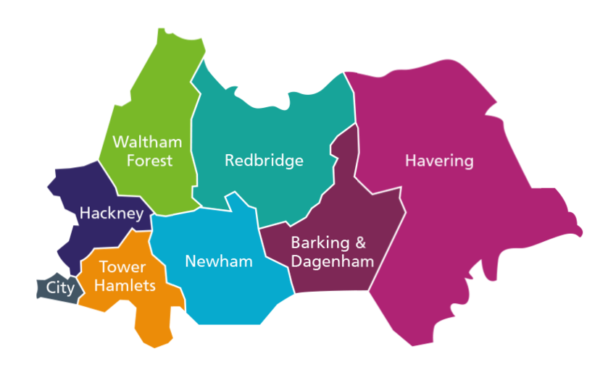
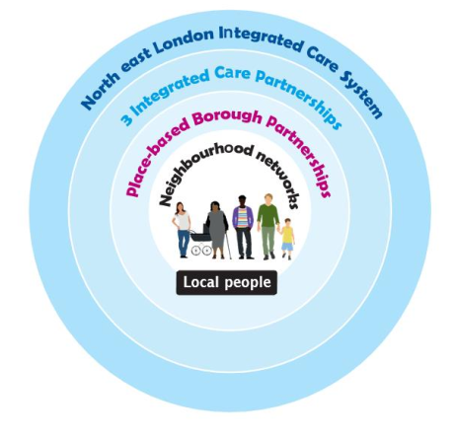
Background
ICS – a new way of working for health and care
An Integrated Care System (ICS) is the place where all NHS bodies and their partners come together to co-operate in delivering the “Triple Aim” of: better care for all patients, better health and wellbeing for everyone, and sustainable use of NHS resources.
It replaces the previous arrangements of competition between bodies to one of co-operation and integration, with all organisations working to the common purpose of improving population health.
ICS’s strengthen this way of working with the expected creation of statutory NHS Integrated Care Systems in April 2022, that will take over the commissioning role of CCGs (which will be abolished) and some strategic commissioning responsibilities from NHS England. The ICS will also include system leaders from constituent local organisations like NHS Trusts and Local Authorities.
NHS Trusts and Foundation Trusts (FTs) will remain separate statutory bodies with their functions and duties broadly as they are in the current legislation. But they will be part of the ICS and performance and financial regimes will tie these organisations more closely together, with financial allocation and other financial objectives set at a system level for all organisations to deliver.
North East London ICS
NEL ICS serves a population of about 2m people, consists of 5 NHS Trusts, 8 local authorities, 49 PCNs, 276 GP practices and a myriad of other stakeholders.
We operate a federated model, where decision-making takes place as close to the patient as possible but where we come together to strategically plan, co-ordinate delivery and manage performance.
The building block is the borough-based partnerships where the NHS works closely with Local Authority and other partners to help people stay healthy and tackle inequalities.
Our boroughs come together into local Integrated Care Partnerships (ICPs) across ‘places’ in City and Hackney (C&H), Barking and Dagenham, Havering and Redbridge (BHR), and Tower Hamlets, Newham and Waltham Forest (TNW).

Slide 3
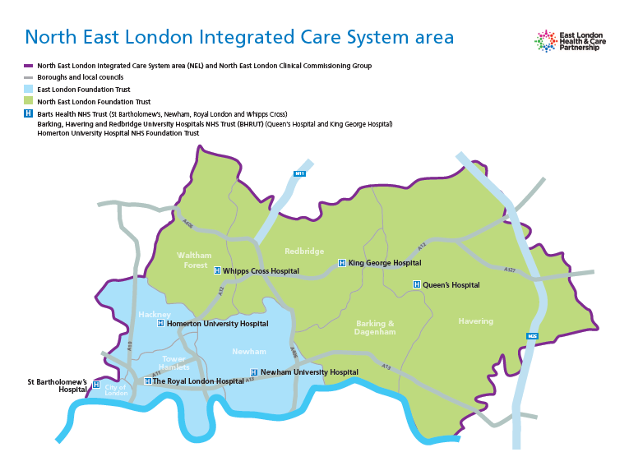

Slide 4
Homeless Health in NEL
North East London (NEL) has almost a quarter of the capital’s total of people sleeping rough.
More than half of those who sleep rough in north east London report issues with mental illness, physical ill health and substance misuse.
Three dedicated GP practices for homeless in City & Hackney, Tower Hamlets and Newham
Pathway teams in Royal London and Homerton
Community outreach provision in across NEL – providing healthcare assessments and supporting registration with a GP
Mix of CVS provision across the NEL footprint working with statutory providers and commissioners to improve health outcomes

