Slide 1
Integrated Care System
SEL Integrated Care System

Slide 2
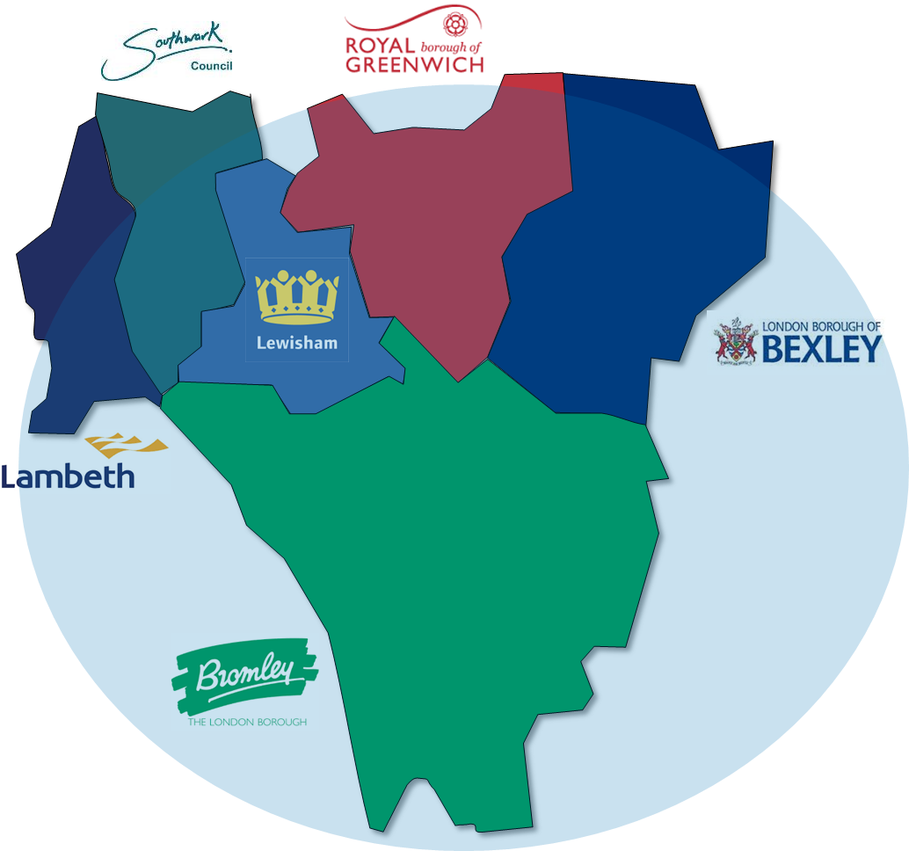
Our partnership brings together health care organisations, local authorities and other partners from across our six boroughs
The London boroughs of Lambeth, Southwark, Lewisham, Greenwich, Bromley and Bexley are home to two million people, supported by:
The six South East London local authorities, delivering and commissioning a wide range of care services and wider services important to health and well being
212 individual GP Practices, alongside community pharmacies, dentistry, optometry, organised within neighbourhood-based 35 Primary Care Networks
Guy’s & St Thomas' NHS Foundation Trust
King’s College Hospital NHS Foundation Trust
Lewisham & Greenwich NHS Trust
Oxleas NHS Foundation Trust
South London & Maudsley NHS Foundation Trust
Bromley Healthcare CIC
Dartford & Gravesham NHS Trust*
King’s Health Partners, our academic health science centre
Thousands of local voluntary & community organisations
NHS South East London Clinical Commissioning Group
We come together to provide health and care support and services as a “system of systems” through:
our work as South East London Integrated Care System
our Provider Collaboratives
our six Local Care Partnerships
our 35 Primary Care Networks
* Although Dartford & Gravesham NHS Trust is outside of South East London the trust provides significant numbers of hospital services to Bexley residents

Slide 3
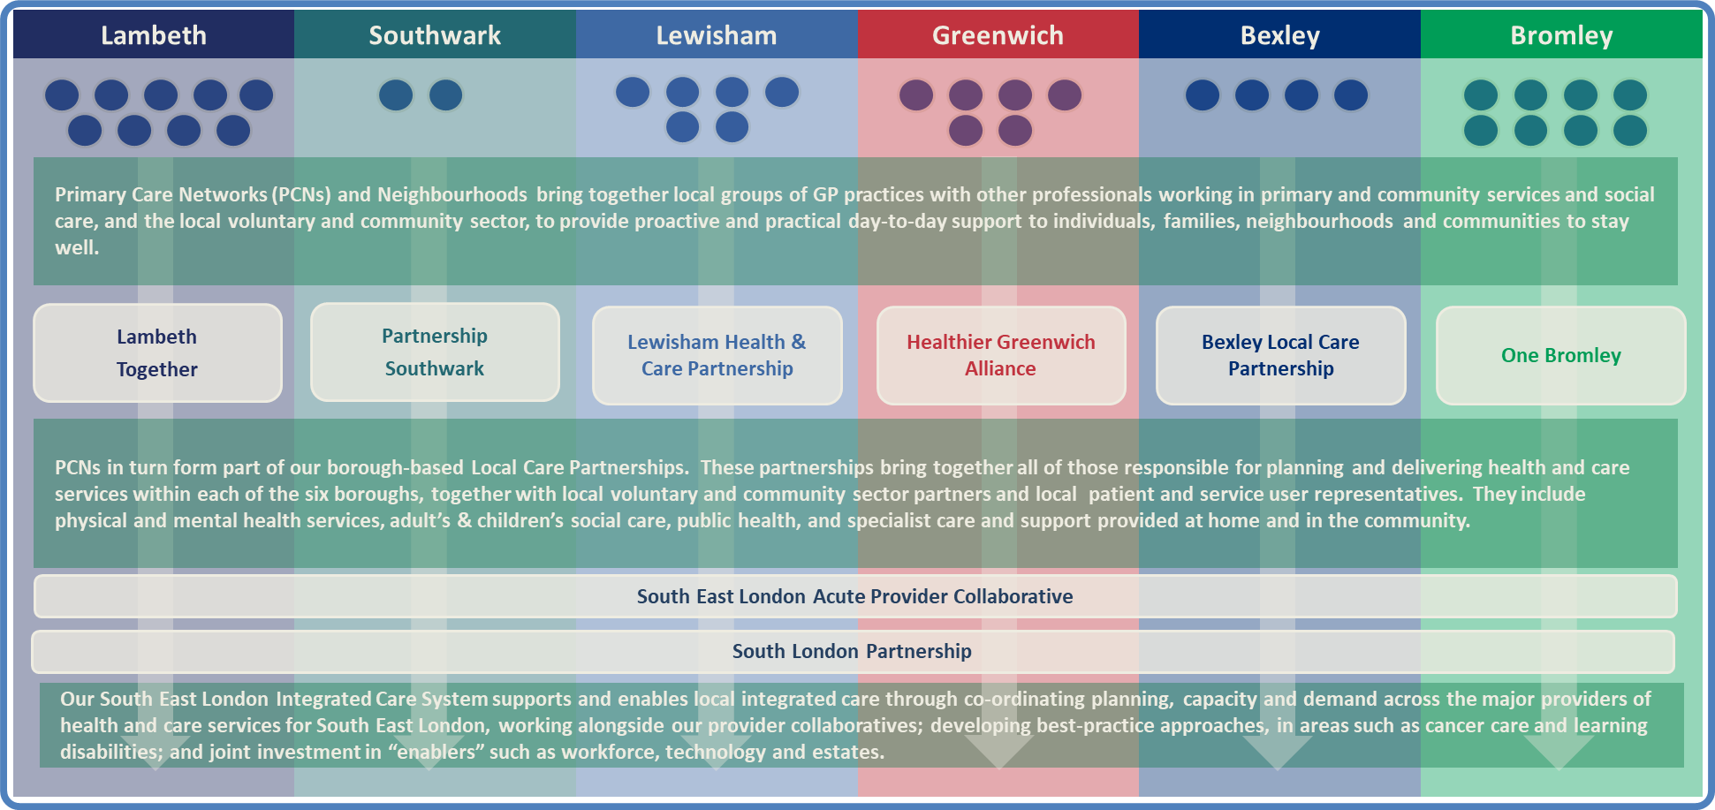
Our ICS includes local care partnerships at the level of our boroughs, primary care networks and collaborative partnerships bringing together health services

Slide 4
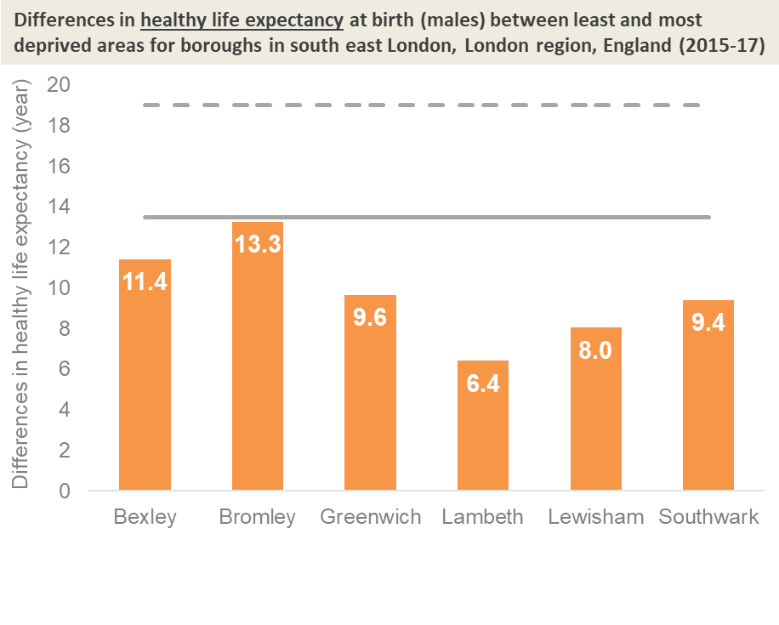
Overview of our population characteristics in south east London
Growing and aging
South east London has a population of around 1.9 million, with some very densely populated areas; Lambeth and Southwark are in the top 9 most densely populated boroughs in England. We forecast yearly population growth over the next ten years, although the rate of growth will lessen over this period.
The split of young and aging population varies between our boroughs currently but generally, like most of the country, our population is aging. Our forecast population growth is pronounced in the older populations of 64-75 year olds, and there is an increase in the age distribution of over 65s over this ten year period.
Highly diverse
The proportion of the population who are black and minority ethnic ranges from 19% in Bromley to over 50% in Lambeth.
South east London has a higher than average proportion of residents that identify as LGBTQI+. Lambeth and Southwark have the second and third largest lesbian, gay and bisexual communities in England.
There is a large prison population, with over 3,500 adult men and young adults across four prisons situated in Greenwich and Lambeth.
Significant Levels of Deprivation
Four of our six boroughs, Lambeth, Southwark, Lewisham and Greenwich, rank amongst the 15% most deprived local authority areas in the country
Life expectancy and healthy life expectancy
Life expectancy and healthy life expectancy at birth remain below the national and London averages for many of our boroughs. Between our boroughs, life expectancy is similar but healthy life expectancy does vary significantly, particularly for females.
This difference in life and healthy life expectancy may be attributed to deprivation. Between the least and most deprived areas within a borough, healthy life expectancy can vary by up thirteen years and life expectancy at birth by up to nine years.

Slide 5
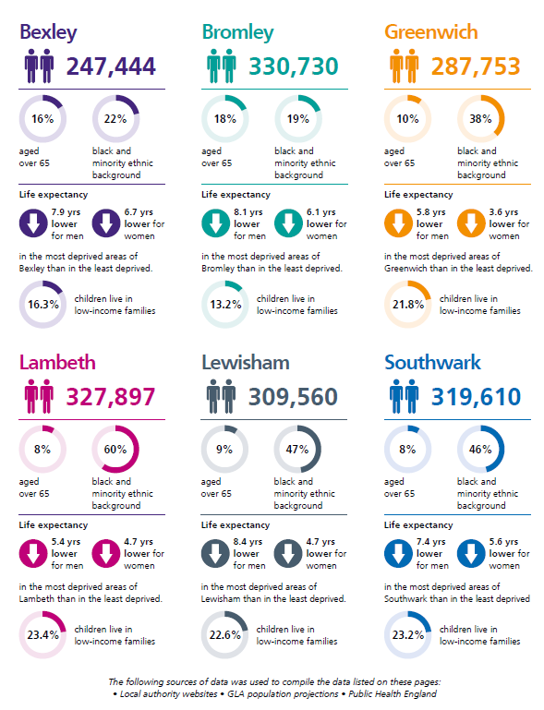
Our borough populations in south east London share some commonalities, but also have their own unique characteristics, complexities and needs
Our populations as described in our January 2020 NHS Long Term Plan response:
Bexley - Population is estimated to increase by 9% between 2019 and 2030. One in six people are over 65 and projections show that Bexley has a population that is ageing. Bexley has a relatively younger, ethnically diverse and deprived population towards the north.
Bromley - An ageing population, the proportion of people aged 65 and over is expected to increase to 19% by 2027. 19% of the population are from BAME backgrounds, with children and young people make up the highest proportion of the BAME population.
Greenwich - Almost 25% are under 19 and around 10% are over 65, and about 20% of the population are from BAME backgrounds. Greenwich has particular challenges including high levels of deprivation, inequalities and unemployment.
Lambeth - A young and diverse population, 51% are between 20-44 and over 50% of the population are from the black, Asian and minority ethnic (BAME) community. People can live for between 15 and 20 years in poor health.
Southwark - A comparatively young and diverse borough with more than 120 languages spoken and 39% of residents born outside the UK. Around 15,000 children under 16 live in low income families. The 40th most deprived local authority in England and the 9th in London.
Lewisham - 25% of the population are under 19 and almost 10% are over 65. A very diverse borough 47% of the population are from a BAME background. In 2015 Lewisham ranked as the 48th most deprived local authority in England and 10th in London.

Slide 6
There is a high prevalence of factors that we know have a major impact on health and wellbeing, including obesity, smoking and alcohol consumption
High blood pressure, poor mental health, obesity, smoking and alcohol are driving poor health and mortality in our populations.
We know that there is scope to significantly improve prevention, detection, health promotion, management and treatment of these and related conditions.
Long term conditions associated with the ‘vital five’ include hypertension, anxiety, depression, diabetes, heart disease, cancer, respiratory disease, liver disease and cancer.
Disability adjusted life years (DALYs) by risk factor, boroughs in south east London, both sexes, all ages, 2017
The Vital Five

Slide 7
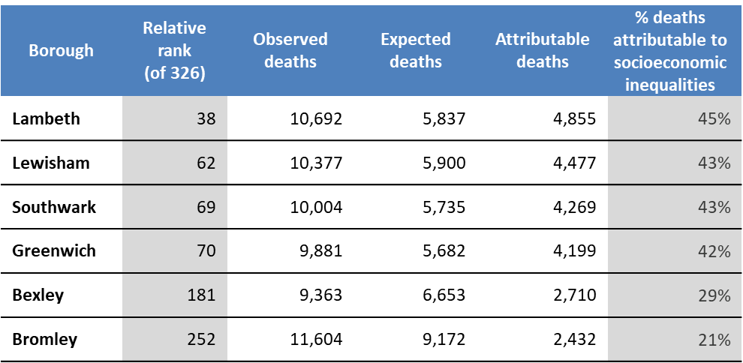
C. As well as the most deprived, there is evidence that the pandemic is having a disproportionate impact on ethnic minorities in SEL
There are extremely high levels of deaths attributable to social-economic inequalities in our boroughs.
Ethnic minorities are suffering the greatest economic hardship, which in turn will impact on health.
44% of Black respondents to a local survey reported struggling to pay rent/ mortgage, utilities, food
Figure 1: The impact of COVID-19 on household income, by ethnicity (ComRes survey)
D. Lewer et al, Premature mortality attributable to socioeconomic inequality in England between 2003 and 2018: an observational study (The Lancet Public Health, 2019). See data: https://public.tableau.com/profile/rob.aldridge#!/vizhome/MATI_19_11_25/MATI_dashboard

Slide 8
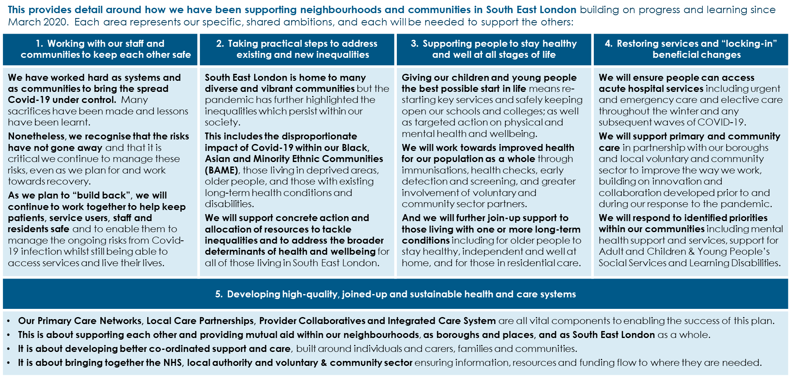
Our COVID recovery and how we will support our communities have informed our priorities within our System Development Plan

Slide 9
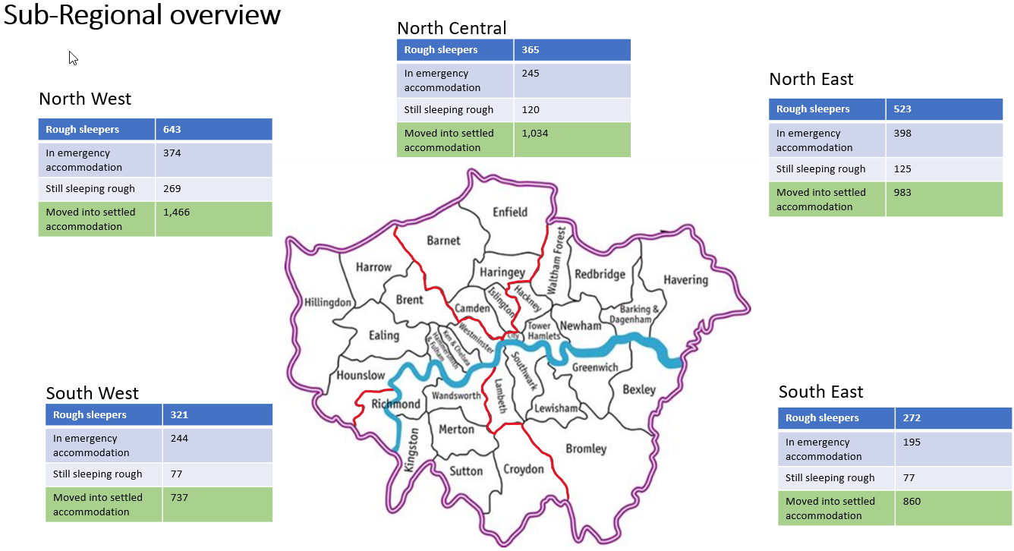
Homeless Health Sitrep Oct 21

Slide 10
Homeless Health SEL Group key deliverables
Ensuring the SEL homeless population can access and receive the help they need including: Health Needs Analysis undertaken and acted on, registration/access to GPs, access to accommodation, access to other health services, particularly substance misuse and mental health
Reducing the number of homeless patients currently resorting to hospital urgent care and those admitted to hospital Engagement of ICS clinical and operational leaders to ensure that the Inclusion Health agenda is integrated into ICS strategic planning
Establishing effective links and developing common understanding across SEL to maximise opportunities for improvement, including the recognition of areas that have particular challenges in this area
Establish and maintain communication and engagement with stakeholders that are relevant to homeless health in SEL
Develop plans to address the complex issues including those with no Recourse to Public Funds, individuals who cannot demonstrate a local connection, etc
Oversight of Vaccination programmes aimed at the Homeless/Rough Sleeper population
Improving Primary Care access and support with an intention to develop a core offer
Strategic Oversight of Out of Hospital models of care pilots (Shared Outcomes Fund)

