Slide 1


Understanding the speech, language & communication needs of people who are experiencing homelessness
Chair: Lauren Page-Hammick, Homeless Link
Speakers:
Leigh Andrews, Speech & Language Therapist
Jacqui Learoyd, Speech & Language Therapist
Nana Asamoah, Student Speech & Language Therapist
Claire Westwood, Speech & Language Therapist

Slide 2

Communication
“You all talk too &%**! Much”
Jacqui Learoyd
Lead SLT
HMP Berwyn
Claire Westwood
Lead SLT
West Midlands Violence Reduction Unit
Sandwell Youth Offending Team

Slide 3
COMMUNICATION
Understanding
language
Talking
Attention
Social skills
Speech sounds
Stuttering
Notes:
Communication chain

Slide 4

Meet ‘Joe’
Typical young person in prison
What research says
In his early to mid 20’s
In and out of care as a teenager
Struggled in school and was labelled a ‘behavioural problem’, excluded from school
Sofa surfing
Ends up living rough at age 18 and gets involved in ‘petty crime’
Lives a ‘chaotic lifestyle’
Very low self esteem
A person with this profile is likely to attract court orders, which they breach, and end up with numerous short custodial sentence(s)
Short sentences are very harmful to the potential for a stable living environment
Living rough, being involved in ‘street activities’, being in care and misusing substances are the 4 biggest risks for social exclusion
Social exclusion increases risks associated with homelessness and re-offending

Slide 5
What a lay person might see
Lay persons view
What research says
They can’t read and write because they dropped out of school
They are ‘bad’, ‘scary’, ‘dangerous’
They probably came from problem families
They could change their future / destiny / prospects if they tried harder
My neighbours sisters friend was in care and he turned out alright
You need to understand a person in their context to be able to understand their needs
Young people in prison have much higher rates of multiple and complex health / social problems compared with young people in the general population
Many of these needs are unrecognized and unmet

Slide 6
What do I see?
Speech and Language Therapist observations
What the research says
Asks the same question several times before ‘they get it’
Doesn’t understand ‘everything that is said to them’ but doesn’t admit this
Keeps breaking a rule even when told it lots of times
Eventually ‘snaps’ and breaks ‘something’
Can’t explain why they broke the ‘something’
Struggles to tell me their story
Can’t answer the question ‘remind me what we said?’
Language is an essential part of social relations and serves several functions in social interactions
the failure to acquire and use developmentally appropriate language may contribute to non-verbal, aggressive behaviours
may learn that antisocial behaviours are the most effective means of communicating their needs and achieving a desired outcome
delinquent behaviour may represent an adaptation strategy for language-impaired people, providing an alternative way to obtain acceptance and maintain social position
Up to 80% of people in prison have problems understanding information, processing information, expressing themselves and explaining a change of events and following a set of instructions with multiple steps

Slide 7
What about you?
What you might see
What you could do
Great at chatting about their topic e.g. football but stuck when you want to discuss something new e.g. benefits
Uses superficial phrases e.g. ‘you get me’ to pad out what they are trying to say
Gets lost / runs out of words when explaining what happened
Asks you the same question several times
Can’t remember your name, your appointment or what you planned
Needs more thinking time or seems to be three sentences behind in the conversation
Body language that does not match the situation
Ask if they have ever had a blow to the head (this is a red flag) (more blows to the head = more red flags)
Be subtle, but check. Ask ‘remind what we said I would do?’ (and if they can’t tell you, it’s a red flag)
Have a pen and notebook, and write brief notes or draw for them – then give it to them!!
Slow down!! Talk more slowly. Wait. Use easy words

Slide 8

Why is knowledge about communication difficulties important for those who work in homelessness?
It’s very common
It’s often undiagnosed
It is key to enabling people to access support (health and social care, employment, benefits).

Slide 9

Why are they missed?
These people can be labelled as ‘naughty’, ‘lazy’ or ‘uncooperative’.
Communication difficulties masquerade as other conditions
Communication difficulties are hard to spot
Notes:
E.g. behavioural difficulties due to a sense of frustration at being unable to express themselves clearly or be properly understood.
Can be grouped with learning difficulty or learning disability.
Professionals and the media
They’ve had to struggle through without understanding or being able to express themselves for so long they’ve develop strategies.
Hidden disability
King’s Speech

Slide 10
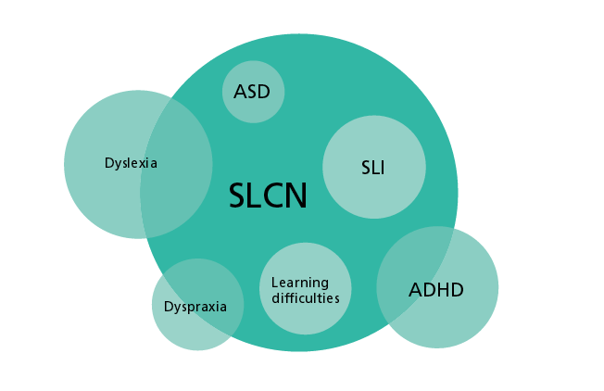
SLCN = Speech, Language and Communication Need

Slide 11
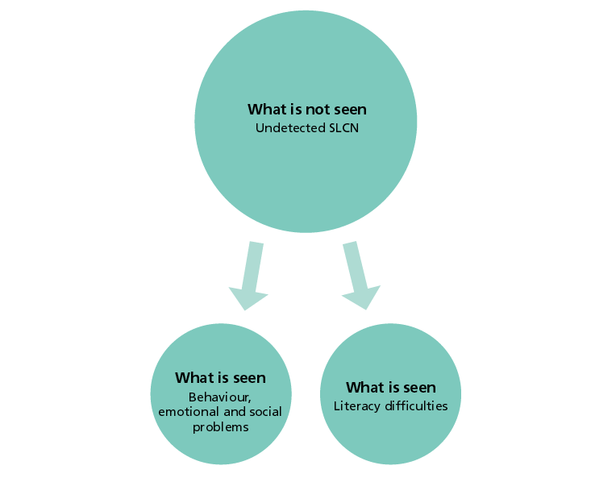
SLCN = Speech, Language and Communication Need

Slide 12

7 Red flags!
Poor achievement at school
Difficulty coping at school
Attendance at any sort of special school
Difficulty managing processes such as housing and benefits
Not understanding court or probation processes
Avoidance of situations that require communication, such as attendance at support groups / self help groups
Difficulty in providing information even when the other person present is clearly there to help
Notes:
Taken from a toolkit for prison and probation staff
How many of our YP’s hit at least one of these??

Slide 13

Never assume that a communication difficulty will have been picked up previously!
Notes:
In education, by GPs, by other health professionals…
You’ll often be the first ones to pick this up!

Slide 14
What can you do to help?

Slide 15
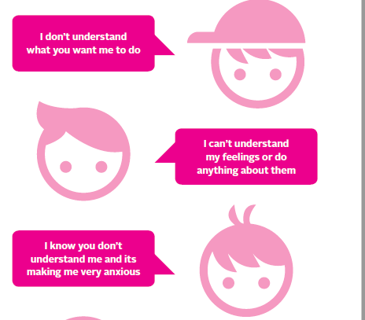
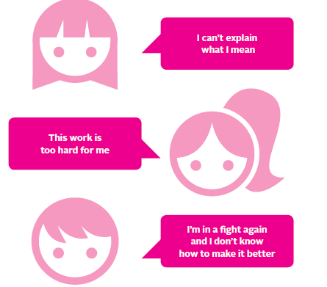
Understand behaviour as communication

Slide 16

We can aim to:
Maximise successful communication
Minimise confrontation

Slide 17
Verbal strategies
Say the person’s name at the start of an instruction
Make instructions short and simple
Pause between instructions so they have time to process information
Check understanding by getting them to summarise what they know
Don’t say ‘do you understand?’
Notes:
Activity
Normalise asking for help for whole class, create opportunities for this e.g. a card to give to teacher/put on desk, praise her for asking.

Slide 18
AVOID
Trying to get them to rationalise when upset
Don’t ask ‘how?’/ ‘why?’ questions until they’ve calmed down
Being sarcastic or using banter

Slide 19
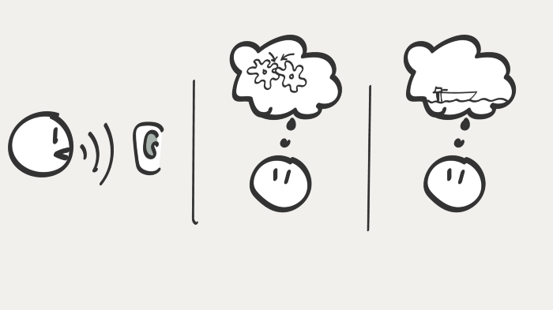

Why Draw to Communicate?
Interpreting others’ words is difficult. Are we talking about the same boat?
A drawing just works. The listener doesn’t need to spend a lot of time interpreting it.

Slide 20


Slide 21

Three Golden Rules
1. Dump all professional language
2. Shut up more than you need to – tolerate silence
3. Draw what you’re saying – don’t go near client without pen and paper!

Slide 22

Thank you for listening
Find Claire and Jacqui on Twitter
@Claire_SLT
@JacquiLearoyd

Slide 23
References
Madoc-Jones, I., Ahmed, A., Hughes, C., Dubberley, S., Gorden, C., Washington-Dyer, K., Lockwood, K. and Wilding, M., 2020. Imaginary homelessness prevention with prison leavers in Wales. Social Policy and Society, 19(1), pp.145-155.
Madoc-Jones, I., Hughes, C., Gorden, C., Dubberley, S., Washington-Dyer, K., Ahmed, A., Lockwood, K. and Wilding, M., 2018. Rethinking preventing homelessness amongst prison leavers. European Journal of Probation, 10(3), pp.215-231.
Fitzpatrick, S., Johnsen, S. and White, M., 2011. Multiple exclusion homelessness in the UK: key patterns and intersections. Social Policy and Society, 10(4), p.501.
Dada, T (2020) “Pupils excluded from school might as well be given a prison sentence”, The Common Sense Network, https://www.tcsnetwork.co.uk/
Søndenaa, E., Wangsholm, M. and Roos, E., 2016. Case characteristics of prisoners with communication problems. Open Journal of Social Sciences, 4(04), p.31.
Morken, F., Jones, L.Ø. and Helland, W.A., 2021. Disorders of language and literacy in the prison population: A scoping review. Education Sciences, 11(2), p.77.
Lennox, C., 2014. The health needs of young people in prison. Br Med Bull, 112(1), pp.17-25.
Why draw to communicate at https://knowitlabs.no/how-to-draw-to-communicate-101fd9e0afad

Slide 24
Communication
Racism, inequality and discrimination

Slide 25
“And if there’s one aspect of a person’s identity that betrays social class above all others, it’s the way we speak.”
Rob Drummond
Senior Lecturer in Linguistics
Manchester Metropolitan University

Slide 26



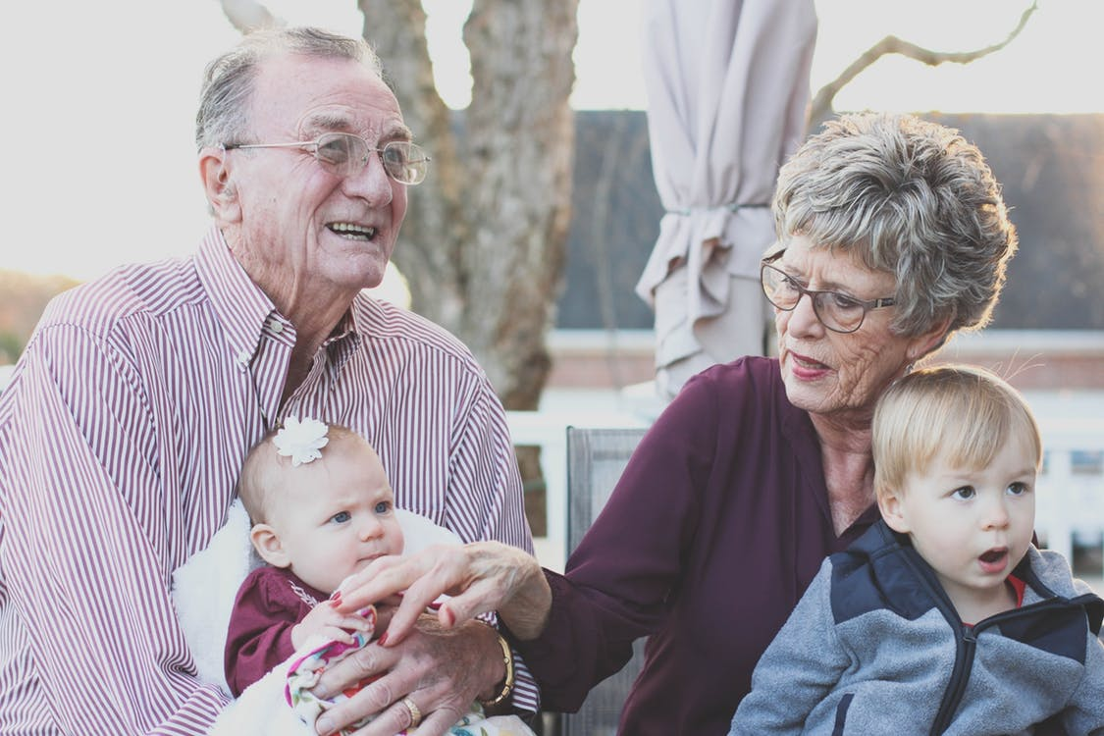

Slide 27
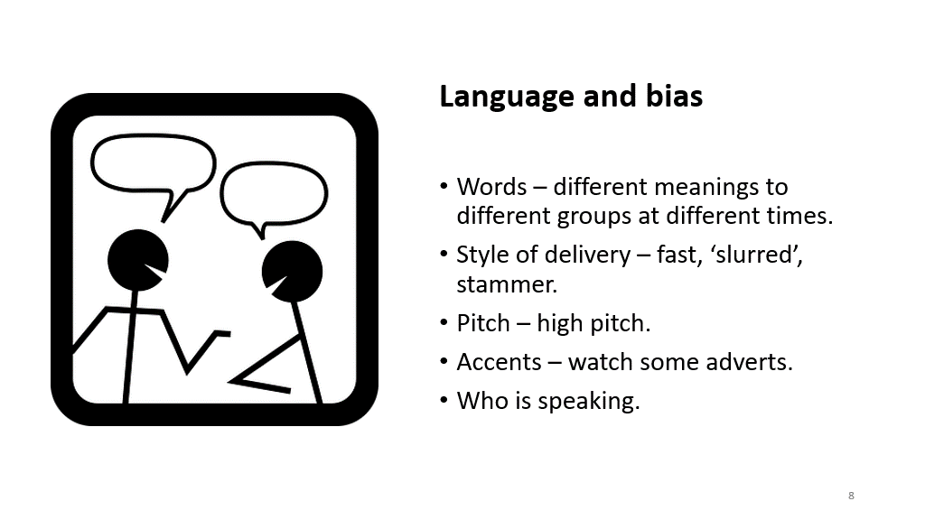
Andrews & Botting (2019)​
74% of new rough sleepers were recorded as having some level of communication need.​​
(10% of UK population experience persistent communication need).​
​
G. Pluck and colleagues (2020)​
People with experience of rough sleeping were more likely to have language difficulties than those from a similar background who had not slept rough.​

Slide 28


Which ethnic group do you think has the highest exclusion rate in England?
Poll

Slide 29
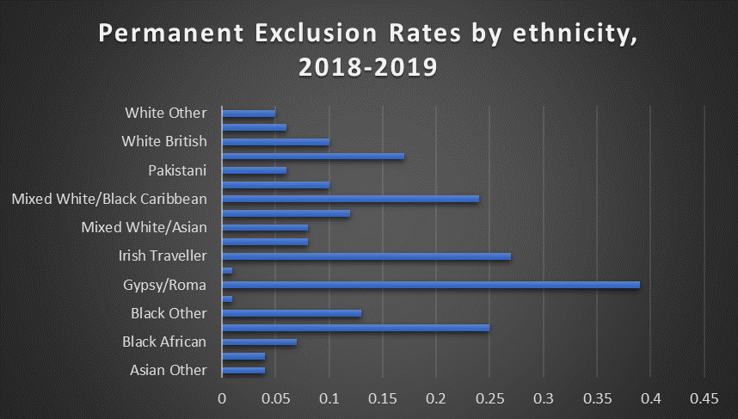
Education: Statistics on exclusion rates in England from 2018-2019
Permanent Exclusions:
-Gypsy/Roma – 0.39%
-Irish Travellers – 0.27%
-Black Caribbean – 0.25%
-Mixed White/Black Caribbean – 0.24%
-Unknown – 0.17%
-White British – 0.10%
From GOV.UK - https://www.ethnicity-facts-figures.service.gov.uk/education-skills-and-training/absence-and-exclusions/permanent-exclusions/latest

Slide 30
Some findings from the Timpson 2019 report on school exclusions in the UK
'This review primarily spoke to the parents and carers of children who had been excluded. Often their children had additional needs such as SEN or attachment disorder, and many wrote that their child’s exclusion was a symptom of the school’s failure to understand and address their needs.'
'Staff in special schools in several areas were concerned about a lack of places in specialist settings for pupils with particular needs (often those more likely to be excluded), namely schools for children with autism or social, emotional and mental health (SEMH) needs. They reported that this results in pupils being placed in unsuitable schools, creating pressure on mainstream and other special schools to meet the needs of children when it may be outside their area of expertise'
Trends in groups who have higher rates of temporary and permanent exclusion - 'Includes boys, children with SEN, those who have been supported by social care or come from disadvantaged backgrounds, and children from certain ethnic groups.'
Criticism of the Timpson Report – Suggestion of downplay of ethnic disparities in school exclusions - https://www.theguardian.com/education/2019/may/09/address-the-injustice-of-racial-inequalities-in-school-exclusions
- Complex picture with some variations in the views of children, parents, schools and LAs interviewed about the use of exclusions https://assets.publishing.service.gov.uk/government/uploads/system/uploads/attachment_data/file/807862/Timpson_review.pdf

Slide 31
Education and Ethnicity - Research
Attitudes to the language and identity of Romanian Roma migrants in a UK school setting – Matras, Howley and Jones (2020)- https://doi.org/10.1080/14675986.2020.1728092
Education and Gypsies/Travellers: ‘contradictions and significant silences’ (Lloyd and McCluskey, 2008)
'How Black Working-Class Youth are Criminalised and Excluded in the English School System – A London Study' (2020) https://irr.org.uk/wp-content/uploads/2020/09/How-Black-Working-Class-Youth-are-Criminalised-and-Excluded-in-the-English-School-System.pdf
'The Young Black Experience of Institutional Racism in the UK' (2020) https://www.ymca.org.uk/wp-content/uploads/2020/10/ymca-young-and-black.pdf
Exclusion rates five times higher for black Caribbean pupils in parts of England (2021)- https://www.theguardian.com/education/2021/mar/24/exclusion-rates-black-caribbean-pupils-england

Slide 32
Language policing in schools (Cushing,2019) https://www.cambridge.org/core/journals/language-in-society/article/policy-and-policing-of-language-in-schools/6C4BC80399E27747D34819060E186A62
'Use of evaluative adjectives and adverbs such as ‘poor’, ‘incorrect’, and ‘[speak] properly’ used to describe nonstandardised language.'
'Language was frequently used as a proxy for other social factors such as crime, economic prosperity, employment chances, academic achievement, and the maintenance of social standards'.
The use of policing and criminal language and metaphor used to school policy and teaching to uphold Standard English e.g. 'zero-terolance'. Examples highlighted include:
Posters will be placed around the school displaying the banned words while teachers have been told to listen out and crackdown on rule breakers (Curtis 2016)
Banned words are put into “word jails” on classroom walls (Griffiths & Henry 2019)
I police things pretty closely in terms of the language they use and the words they say (Rachel)

Slide 33

Healthcare Barriers – Use of jargon
Royal College of Physicians – raised concerns about jargon use and individuals and groups not accessing medical care (BMJ, 2014) https://www.bmj.com/content/348/bmj.g4131
Doctors told to ditch Latin and use 'plain English’ – (BBC, 2018) https://www.bbc.co.uk/news/health-45394620

Slide 34
Examples of Barriers and Discrimination in Healthcare
Use of ‘Do Not Attempt CPR’ with people with Learning Disabilities by GPs and in hospitals in relation to COVID-19 treatment - https://www.homecare.co.uk/news/article.cfm/id/1644598/Do-not-resuscitate-orders-must-not-apply https://www.autism.org.uk/what-we-do/news/coronavirus-access-to-health-services
‘Perceived barriers to accessing mental health services among black and minority ethnic (BME) communities’ - https://bmjopen.bmj.com/content/6/11/e012337
‘Gypsy, Roma and Traveller access to and engagement with health services: a systematic review’ (2018) - https://academic.oup.com/eurpub/article/28/1/74/4811973

Slide 35
SLT experience in homelessness settings
Age - ADHD, ASD, SEMH likely to be missed by institutions?
School exclusion – we are working with groups most likely to be excluded.
Criminal justice system – approx. a third of people rough sleeping have been in prison where literacy levels are low.
Substance use at early age – difficulties blamed on intoxication therefore missed and stigmatized.
Communication issues attributed to deliberate acts or emotional intent – lack of awareness of brain processing.

Slide 36
The law – is it helping?
Human Rights Declaration Article 19
Equalities Act 2010
Accessible Information Standard - legal requirement for publicly funded health and social care.
Organizational policies
Organizational training

Slide 37
How to address bias and help
https://accentbiasbritain.org/training-intervention/
Twitter: SLTs of Colour @OfSLTs, @RobDrummond, @RECLAIMProject
Review organizational of legal obligations and training content.
What is the person saying? Listen to words not the way it is said!
Does anyone else communicate well with person – what are they doing?
Are issues present when substance use active AND not active.
Consider triggers to challenging behaviour.
Speak to GP, SLT, psychologist.

Slide 38
Understanding the speech, language & communication needs of people who are experiencing homelessness
Thank you for watching!

