Slide 1



Unlocking the door
A roadmap for supporting non-UK nationals facing homelessness in England

Slide 2

Our research approach
July 2021-March 2022
Partnership with Bedford, Haringey, Manchester City
49 stakeholder interviews
Wider collection of practice examples
Research & advisory from lived experience – NACCOM Community Researchers

Slide 3
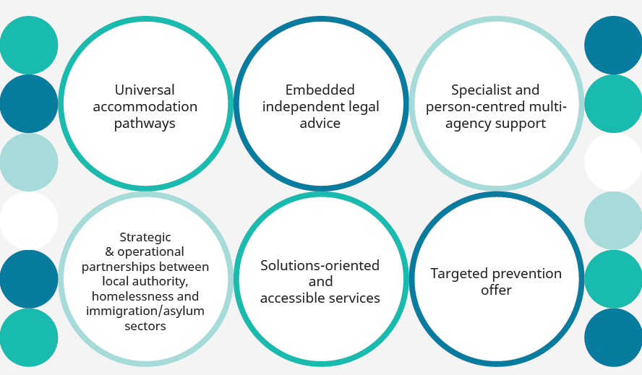
Saying ‘Yes’
Building services that work for all

Slide 4
Saying ‘Yes’
Building services that work for all
“COVID came at the right time… we just said ‘Yes’.
Imagine a world where the first answer isn’t ‘No.’”
local authority interviewee
Universal accommodation pathways
Remarkable benefits to expediting/enabling homelessness and immigration outcomes
Local authority funding role, e.g.
  Rent free assessment beds
  Funding charity providers
  Public health
Local authority facilitative role, e.g.
  Cross-subsidised schemes; hosting; peppercorn rent…

Slide 5
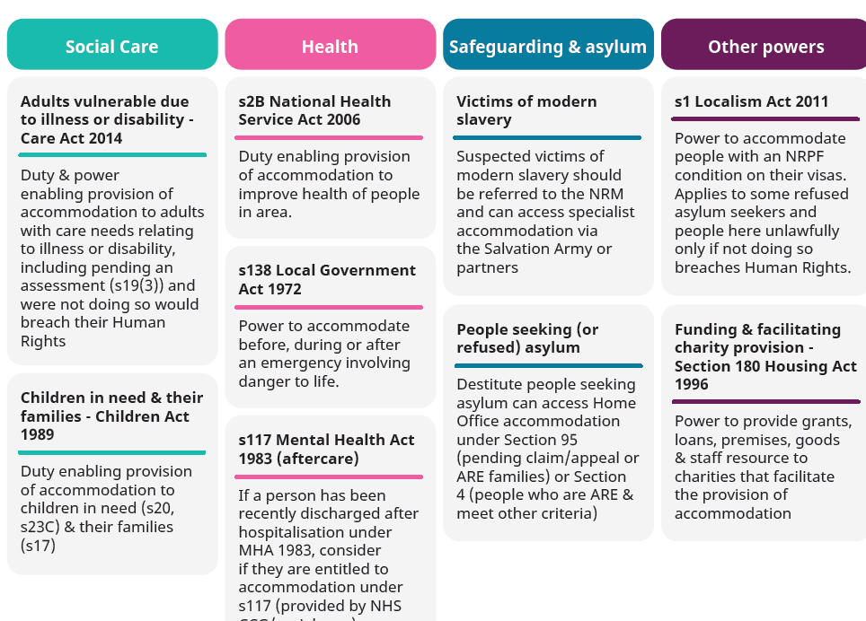

Slide 6
Saying ‘Yes’
Building services that work for all
Opening doors (and making it known)
Prevention and welcome
Taking account of fear, culture and language
Advice and partnerships
Blockages & capacity gaps, especially for complex cases
Quality and unscrupulous private solicitors
Knock-on benefits on immigration literacy for homelessness staff

Slide 7
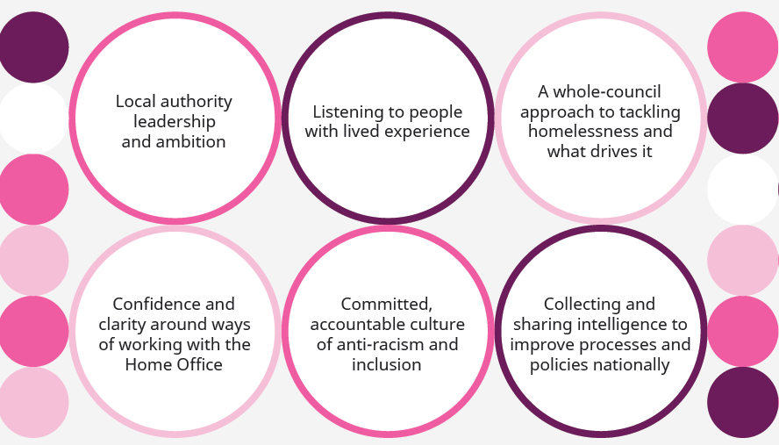
“It can’t just be a sticking plaster”
Creating the foundations for inclusion

Slide 8
“It can’t just be a sticking plaster”
Creating the foundations for inclusion
Whole-council leadership
Overarching commitments & strategies make a difference and should include social care, public health and homelessness
Huge unexplored potential to build pathways and share expertise, good practice and budgets.

Slide 9

“It can’t just be a sticking plaster”
Creating the foundations for inclusion
Confronting racism and discrimination
Immigration-based restrictions are inevitably racially and ethnically coded
First interaction is crucial – people report feeling ‘dehumanised’, dismissed and distrusted, and linked this to their race
Even if support options are limited, there is an opportunity for trauma-informed, solutions-oriented communication, referrals and advice, that takes experiences in the immigration and asylum systems into account.
Notes:
Racism and discrimination by frontline homelessness services was one of the main issues raised by focus group participants
This was also a concern among charity stakeholders, around inappropriate refusals of support in social care and assumptions about immigration status based on race
When it comes to immigration-based restrictions on services in the context of wider hostile environment policies, we cannot ignore the risk of perceived or real racism
Really highlights the importance of welcoming, solutions-oriented Housing Options and other frontline teams, even where options are limited.

Slide 10

“It can’t just be a sticking plaster”
Creating the foundations for inclusion
Learning from lived experience
People with eligibility restrictions have distinct perspectives and experiences of the system
Meaningful involvement at strategic and operational levels brings valuable insights in an area where blind spots are common
Legislative Theatre approach in Greater Manchester and Haringey
Notes:
Experiences of racism show how invaluable the perspective of migrants is to homelessness services
In order to deliver on what’s needed – the culture shift, learning needed to bring non-UK nationals under the umbrella of mainstream homelessness systems – strategies and services need to be informed by local lived experience
It takes time and thought, but the example of Legislative Theatre approach used in haringey and Manchester shows how non-uk nationals’ voices can be represented within wider lived experience groups, and deliver a direct impact. E.g In Greater Manchester, recommendations like anti-racism training to frontline staff were integrated into the Homelessness Prevention Strategy

Slide 11
Facing the national challenge
Closing the accommodation (and funding) gap
Govt funding & leadership to open up accommodation options
Access to justice
Issue of funding and training pipeline for immigration advice
Underpinned by past cuts to legal aid
Reducing delays and improving Home Office decision-making
Potential in the Rough Sleeping Support Service review
The asylum system as a driver of homelessness
Right to work
Bringing eviction notices in line with HRA 56 days
Roll back NABA 2022 s12
Notes:
Lots of ways to tackle this-
Discrete fund
Increasing options for people awaiting decisions
Bring PSS in line with other visa holders to allows change of conditions
Overall review of NRPF policy

Slide 12
Next steps
The Roadmap was written to be used!
Local advocacy
from within councils and from charity partners
National advocacy
Aligning approaches; priorities
Sharing lessons
Collecting and sharing the right intelligence
Notes:
Eg reconnection, coproduction; immigration advice partnership models
Collection of practice examples
Legal analysis on data-sharing and LA funding of accommodation
Overview of accommodation models
services should be advocating locally?

